Slide 1
High Profile Offenders Officer Involved Domestic and Sexual Violence
Lt. Mark Wynn (ret)
www.markwynn.com
markrwynn@edge.net

Slide 2
Objectives
Acknowledge the complexity and challenges posed by officer perpetrated domestic violence
Appreciate the function of policy to establish agency expectations and standards
The common tactics of abusive officers and the intersections with law enforcement training and culture

Slide 3
Domestic Violence
Sexual Assault
Stalking
Interconnected & Co-Occurring
Weapon Violations
Protective Order
Witness Intimidation
Strangulation
Child Abuse
Threats
Vandalism
Voyeurism
Elder Abuse
Course of Conduct Investigation
Unlawful Restraint
Harassment
Custodial Interference
Animal Abuse
Financial crimes
phoenix

Slide 4
Officer Involved Domestic and Sexual Violence
Unique dangers
Threatens agency mission and morale
High liability risk
Impacts public confidence
Questions integrity of the agency
Is there a culture?
There must be a swift, sure and effective intervention
standoff

Slide 5
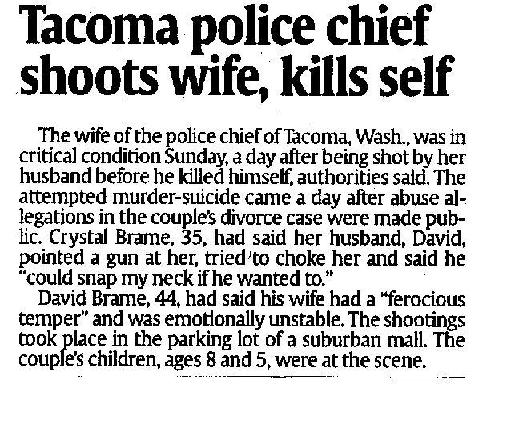

Slide 6
Former State Trooper Sentenced for Cyberstalking - 2015
COLUMBUS, Ohio –William P. Elschlager, 49, of Marietta, Ohio, was sentenced in U.S. District Court to 24 months in prison, three years of supervised release and ordered to pay a $2,500 fine for cyberstalking.
Elschlager was employed with the Ohio State Highway Patrol for 19 years and served as post commander for the Marietta Post. He was employed in law enforcement, in total, for 25 years.
“He used location information from GPS tracking, in conjunction with his law enforcement status, to relentlessly stalk and intimidate his victim,” U.S. Attorney Glassman said. “Elschlager’s position and experience as a law enforcement officer for 25 years makes the offense especially heinous. His actions stripped his victim of a sense of security and safety. Those actions warrant time spent in prison.”

Slide 7
Officer - Victim
A female officer who lives with domestic violence fears people will question how she can protect others if she can't protect herself. She has to choose between jeopardizing her safety by reporting, or possibly violating department policy by remaining silent.
Making a complaint against a police officer is a dangerous act, especially when the complainant is herself an officer. Her abuser can call on his personal and professional network for support and defense against any allegations.
Cooperation between advocates and police can be beneficial to both parties and to many civilian victims, but it presents complex problems when the alleged perpetrator or victim is a police officer.
Diane Wetendorf, Inc.

Slide 8
Traditional Law Response to Domestic Violence
Arrest avoidance and mediation
“Cooling down”
Walk around the block
Ineffective or no training at all
Recruit - In-service - Specialized
70

Slide 9
Traditional Law Response to Domestic Violence
Lack of policies addressing domestic violence for the general public
Officer discretion led to inaction and civil liability
Criminal codes did not define domestic violence

Slide 10
Traditional Law Response to Domestic Violence
Officers rarely receive counseling/training on avoiding physical conflict within their relationships or marriage
Psychological services for officers is often not available

Slide 11
Traditional Law Response to Domestic Violence
No or ineffective screening for domestic/sexual violence history in recruitment
are they batterers when they are hired on or does it happen because of the job?
what kind of people do we hire as police officers?
does psychological testing “weed” them out?
phoenix

Slide 12
Traditional Law Response to Domestic Violence
The law enforcement community is a closed one
Lack of leadership within a department or local government on the issue of domestic violence
A combination of these things may have set the stage for a failure to protect the general public and the police family
phoenix

Slide 13
Blue Code of Silence?
Chief Anthony Bouza of Minneapolis once a commander in the New York Police Department, wrote in his memoir Police Unbound, “The Mafia never enforced its code of blood-sworn omerta with the ferocity, efficacy, and enthusiasm the police bring to the Blue Code of Silence.”

Slide 14
LAPD Inspector General Study
Between 1990 and 1997, Los Angeles Police Department investigated 227 cases of alleged OIDV, of which 91 were sustained; of the 91 sustained by the department, only four resulted in a criminal conviction.

Slide 15
Convictions?
Only 7 percent of Canadian cops convicted of domestic violence received a prison sentence, versus 49 percent of civilians convicted of comparable crimes, according to a study of Canadian cases from 2000 to 2014.
Danielle Sutton, “News Coverage of Officer-Involved Domestic Violence (OIDV): A Comparative Content Analysis” (MA thesis, University of Guelph, 2015), accessed December 15, 2015, https://atrium.lib.uoguelph.ca/xmlui/bitstream/handle/10214/9099/Sutton_Danielle_201508_MA.pdf?sequence=1.

Slide 16
What are the odds?
If police experience domestic violence at the same rate as the general public, studies estimate that 60,000 to 180,000 law enforcement families would be affected by domestic violence annually
(Waters and Ussery, 2007). Experts (Waters and Ussery, 2007;

Slide 17
From the Line
Seventy-three percent of male cops who admitted being violent toward their spouse also admitted they had been violent toward citizens, according to Arizona State University sociologist Leanor Johnson (2000).
The Secret Epidemic of Police Domestic Violence: How It Affects Us All – The Domestic Violence Report 2015 - By Alex Roslin*

Slide 18
From the Line
In 2000 survey of 210 law enforcement officers it was discovered that 54% of officers admitted they knew of officers involved in domestic violence, 16% knew of incidents of unreported OIDV, 31% knew of members in their department who had been disciplined for OIDV, and 55% claimed intervention and prevention programs would be helpful.
Ryan 2000

Slide 19
From the Line
Data obtained from 299 officers in 27 states, found more than half (51.3%) reported they had been called to respond to a domestic violence incident which involved another law enforcement officer.
Russell and Tannenbaum (2016)

Slide 20
Sexual Misconduct
Analyzes of news articles between 2005 and 2011 found 6,724 arrests involving more than 5,500 officers. Sex-related cases were the third-most common, behind violence and profit-motivated crimes. Cato Institute reports released in 2009 and 2010 found sex misconduct the No. 2 complaint against officers, behind excessive force.
Phil Stinson, Bowling Green State University

Slide 21
The Blue Curtain?
Keeping the secret of domestic violence within the family makes it worse by preventing early intervention to save the officer and prolongs the violence increasing the chances of injury, murder and suicide.

Slide 22
The Profile
We are taught to:
control our emotions
discipline our minds to remain focused in dynamic situations
to prevail in the face of adversity
to interrogate when suspicious
to intimidate or match aggression when challenged

Slide 23
The Profile
We are taught to:
to dominate when threatened
command presence, surveillance
control through pain without visible injury
Carotid restraint, wristlocks, arm holds, use of handcuffs
be an authority figure within the community
to use firearms, trained in confrontation
Add to this…..
exceptional pressures of police work
being prone to alcoholism and divorce

Slide 24
The Profile
shift work and court time
unfair publicity
consistent exposure to pain and suffering
Add to this…..
violent behavior learned as a child

Slide 25
The Blue Curtain?
Is there a Code of Silence?
we are good at keeping secrets
we are fraternalistic
we build bonds stemming from life and death situations on the street
DO WE BREAK THIS CODE?

Slide 26
Physical VIOLENCE Sexual
USING COERCION
AND THREATS
USING
INTIMIDATION
Will the offender/officer use power and control against the responding officer?
USING
ECONOMIC
ABUSE
USING
EMOTIONAL
ABUSE
POWER
AND
CONTROL
USING MALE
PRIVILEGE
USING
ISOLATION
Physical VIOLENCE Sexual
USING
CHILDREN
MINIMIZING
DENYING
AND BLAMING

Slide 27
Power and Control Tactics
Intimidation……
Victim knows war stories
Victim knows what he has done in the field
He knows the criminal justice system – DA, Judges
Officer has more credibility in court
Victim won’t be believed
Officer /suspect appears in court in uniform
Other officers coming to court to show support
Taz
under

Slide 28
Power and Control Tactics
Emotional Abuse
Expert at control tactics
Threatens suicide if he/she cost them their job

Slide 29
Power and Control Tactics
Isolation…
Only socialize with law enforcement
Loss of law enforcement – family social circle

Slide 30
Power and Control Tactics
Economic abuse…..
➢ Loss of job, money, pension
He controls the money
“ I’m the bread winner…..”
“ I see you are married. How would like it”?

Slide 31
Power and Control Tactics
Using Male Privilege/Officer Privilege…
Command presence
Access to criminal files
Officers testify against her
Her word against his

Slide 32
Power and Control Tactics
Coercion and threats of greater harm..
Control/pain without visible injury
Coercion and threat by others in department
Stalking by other officer(s)
Pressure from police wives

Slide 33
Power and Control Tactics
Minimizing - Denying - Blaming…..
➢ Stress of the job
“It’s because of all I see and deal with”
Other officers will do this for the suspect
They’ve all heard about her
Supervisor buys into it

Slide 34
Power and Control Tactics
Using the Children…
➢ Threats to take children
Use children for surveillance

Slide 35
Sexual Offenses and Misconduct
“ It is imperative to the protection of citizens’ civil rights and the trust communities place in law enforcement that policies be adopted as part of a clear statement that sexual misconduct will not be tolerated.”
Chief David Nye, Fredericksburg Police Department, VA

Slide 36
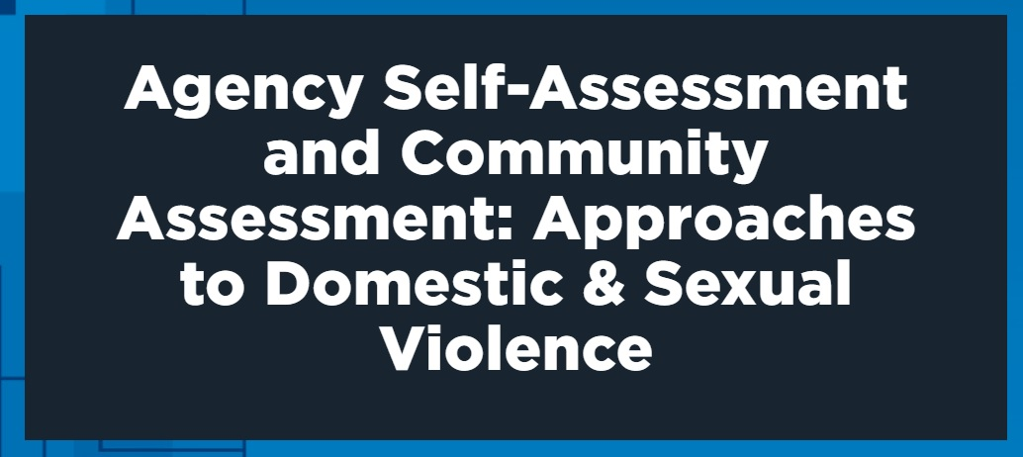
https://www.theiacp.org/GBVAssessments

Slide 38
Sexual Misconduct
Phil Stinson, a researcher at Bowling Green State University, analyzed news articles between 2005 and 2011 and found 6,724 arrests involving more than 5,500 officers. Sex-related cases were the third-most common, behind violence and profit-motivated crimes. Cato Institute reports released in 2009 and 2010 found sex misconduct the No. 2 complaint against officers, behind excessive force.

Slide 39
“He didn’t choose CEOs or soccer moms. He chose women he could count on not telling.”
– Prosecutor Lori McConnell
Notes:
https://www.glamour.com/story/daniel-holtzclaw-trial

Slide 40
Oklahoma’s Daniel Holtzclaw
Holtzclaw chose victims for their perceived vulnerability and lack of credibility
Found to have assaulted 13 black women, most of whom were low income and some who were using alcohol/drugs, and who had prior convictions.
December 20, 2013 – first known sexual assault
May 8, 2014 – Oklahoma City Police began investigating Holtzclaw for sexual assault.
Assaulted 5 more women while still on-duty
June 18, 2014 - Jannie Ligons who did not meet the profile of his other victims was assaulted by Holtzclaw and reported the assault
December 9, 2015 - Convicted of sexual assault for 8 of the 13 victims. Sentenced to 263 years in prison.
Notes:
https://www.glamour.com/story/daniel-holtzclaw-trial
https://www.buzzfeednews.com/article/jtes/daniel-holtzclaw-women-in-their-ow#.dmOZaw6oR
https://www.theguardian.com/us-news/2015/dec/11/daniel-holtzclaw-questions-police-chiefs-rape-Oklahoma
https://abcnews.go.com/US/daniel-holtzclaw-jury-decided-send-oklahoma-city-police/story?id=38549442
Investigation and Prosecution of OCPD Officer Daniel Holtzclaw
April 5, 2016 • Conference on Crimes Against Women • Dallas, TX
Law Enforcement: Kim Davis and Rock Gregory
ADAs: Gayland Gieger and Lori McConnell

Slide 41
Why have a policy for Officer Involved Domestic Violence
Provides guidance
Ensures full investigation
Impact on Agency and community
Polarization of departments members
Media and public image
Addresses liability

Slide 42
Six Most Common Areas of Officer Liability
Failure to take proper actions to protect
Failure to appropriately enforce a court order protecting a victim of domestic violence
Failure to respond at all or in a timely manner
Failure to provide information to a victim as required by law
Arresting a citizen without establishing probable cause
Exhibiting a pattern of differential treatment or application of the law to domestic violence cases

Slide 43
IACP Model Policy

Slide 44
IACP Officer Involved Policy
Prevention
Education and Training
Early Warning and Intervention
Incident Response Protocol
Victim Safety
Post-Incident Administrative and Criminal Decisions

Slide 45
Alberta Police Services and Women’s Shelters Working Relationship Guidelines
INCIDENTS INVOLVING POLICE OFFICERS
In developing the procedures and steps to be followed when a domestic violence occurrence involves a member of a police service, any procedure should, in addition to the general procedures involved in non-member incidents, reflect:
victim safety;
objectivity;
accountability;
confidentiality; and
lack of bias towards the member.
tradition

Slide 46
Policy Implementation
Provide training to supervisory personnel on early warning signs
Select lethality assessment tool
Draft and commit to MOUs with neighboring departments and advocacy agencies
Provide outreach to families of department personnel
Prepare victim assistance resources

Slide 47
Police Officer Certification Information System
The Peace Officer Certification Information System (POCIS) was established to reduce the interstate rehiring of law enforcement officers decertified for misconduct by U.S. Peace Officer Standards and Training (POST) Boards and Commissions. This system provides general information regarding state policies and guidelines as well as access to the searchable National Decertification Index (NDI) by approved law enforcement hiring entities.
www.iadlest.org
410-875-3606

Slide 48
Solutions
Firm, written policies with sanctions for all levels of the department
Better screening for recruits
“One step up” investigations of DV incidents
Speed the investigations
EARLY INTERVENTION

Slide 49
The Nashville Policy
Mandatory reporting
Immediate response investigation by specialized investigators
Lethality/danger - suicide assessments
Notification up the chain
Speedy and thorough investigation

Slide 50
The Nashville Policy
Counseling
Dis-empowerment
Discipline
Dismissal
Prosecution

Slide 51
The Bottom Line
Domestic violence is a crime not a crisis
To hold the public trust we must hold ourselves responsible for crime in the police family
No one is above the law and no one is below it

Slide 52
Recommended reading:
By: Ellen Kirschman, Ph.d
Guilford Press
Book # - ISBN 1-57230-193-17

Slide 53
Diane Wetendorf
http://www.abuseofpower.info/index.htm

