Slide 1
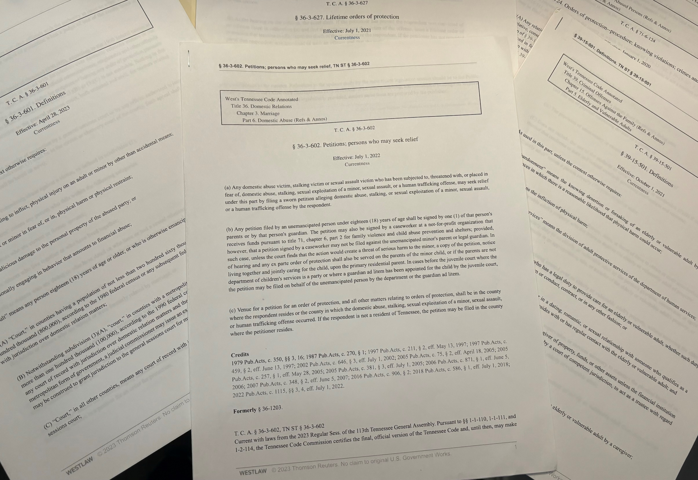
The Three OPs of TN: An overview of Legal Aid and the Tennessee Orders of Protection

Slide 2
Getting to Know Each Other

Slide 3
What is Legal Aid?
Legal Aid Organizations exist in various forms across the state of Tennessee. In general, Legal Aid is available to assist low-income individuals, families, and seniors who normally could not afford civil legal services.
Each organization will have slightly different requirements and areas of law that they can assist with. You should contact your specific organization to familiarize yourself with their requirements.

Slide 4
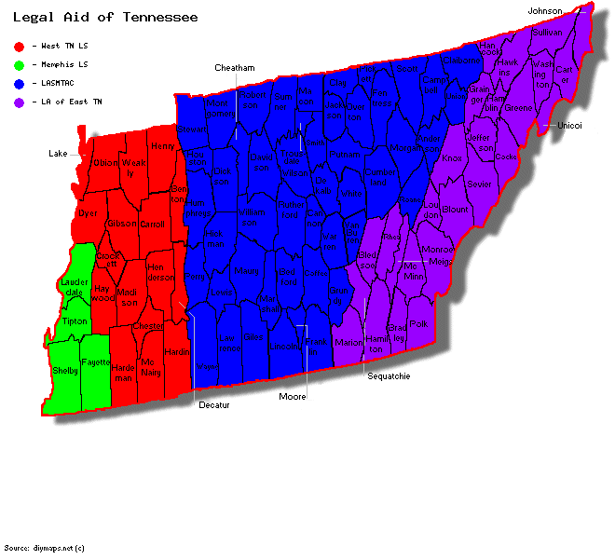
Legal Aid in Tennessee
Legal Aid Society of Middle Tennessee and the Cumberlands
Legal Aid of East Tennessee
West Tennessee Legal Services
Memphis Area Legal Services

Slide 5
Possible Areas of Practice
Consumer Protection
Education
Elder Law
Employment
Family Law
Domestic Violence
Health Law
Housing
Immigration Law
Juvenile Law
Public Benefits
Tax Disputes

Slide 6
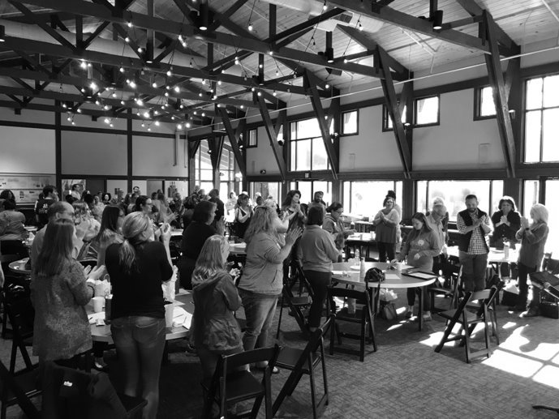
Costs to Clients
If a person qualifies for our help, we provide free legal representation and advice
Our clients only pay for filing fees or other costs assessed by a third party
Ex: fee waivers, ordered costs, paternity tests, service costs

Slide 7
Legal Aid Process
Referral/Call In
Intake
Case Review
Grant Funding Conversation
Possible Representation

Slide 8
Disclaimer: The information provided in this presentation cannot take the place of legal advice. Each case is different and needs individual attention.
Notes:
If you need legal advice on a specific situation, contact our office

Slide 9
OP Statute TCA 36-3-6

Slide 10
OP Statute: TCA 36-3-6: Domestic Abuse
Who is protected? TCA 36-3-601(5):
Tennessee law provides protection for anyone who has been subjected to or threatened with abuse by:
A present or former spouse, someone with whom s/he has lived
An adult family or household member
Someone s/he is dating or has dated
Someone to whom s/he is related by blood or marriage or was formerly related by marriage
Someone with whom s/he has or had a sexual relationship
Protection is also provided for anyone who has been subject to sexual assault or stalking

Slide 11
OP Statute: TCA 36-3-6: Domestic Abuse
What is and is not abuse? TCA 36-3-601(1): Abuse means:
Inflicting, or attempting to inflict, physical injury on an adult or minor by other than accidental means,
Placing an adult or minor in fear of physical harm, physical restraint, malicious damage to the personal property of the abused party,
Including inflicting, or attempting to inflict, physical injury on any animal owned, possessed, leased, kept, or held by an adult or minor, or placing an adult or minor in fear of physical harm to any animal owned, possessed, leased, kept, or held by the adult or minor.
Intentional engaging in behavior that amounts to financial abuse

Slide 12
OP Statute: TCA 36-3-6: Sexual Assault
What must you prove? TCA 36-3-601(10):
“Sexual Assault” is defined as when someone commits, threatens to commit, or puts you in fear that they will commit any of the following acts:
Rape,
Statutory rape,
Sexual battery
Who is Protected? TCA 36-3-601(10):
Any person regardless of their relationship

Slide 13
OP Statute: TCA 36-3-601: Stalking
Who is protected? TCA 36-3-601(5) and 39-17-315:
Tennessee law provides protection for anyone who has been subjected to, threatened with, or placed in fear of a willful course of conduct involving repeated or continuing harassment by anyone regardless of relationship
“Course of Conduct” – a pattern of conduct composed of a series of 2 or more separate noncontinuous acts
“Harassment” – conduct directed toward a victim that includes, but is not limited to, repeated or continuing unconsented contact that would cause a reasonable person to suffer emotion distress and that actually causes the victim to suffer emotion distress
“Unconsented Contact” – any contact with another person that is initiated or continued without that person’s consent, or in disregard of that person’s express desire that the contact be avoided or discontinued.

Slide 14
Case Example

Slide 15
Elder or Vulnerable Adult Abuse OP Statute TCA 71-6-124

Slide 16
Elder or Vulnerable Adult Abuse OP Statute: TCA 71-6-124
Important Definitions from TCA 71-6-102:
“Adult”, under this statute means any person 18 or older who because of mental or physical dysfunctioning or advanced age is unable to manage such person’s own resources, carry out the activities of daily living, or protect such person from neglect, hazardous or abusive situations without assistance from others.
“Advanced Age” – means someone who is 60 years of age or older
“Caretaker” – an individual or institution who has assumed the duty to provide for the care of the adult by contract or agreement. This includes a parent, spouse, adult child or other relative, both biological or by marriage, who:
Resides with or in the same building or regularly visits the adult
Knows or reasonably should know of the adult’s mental or physical dysfunction or advanced age; and
Knows or reasonably should know that the adult is unable to adequately provide for the adult’s own care

Slide 17
Elder or Vulnerable Adult Abuse OP Statute: TCA 71-6-124
Who can bring the suit under TCA 71-6-124:
Any relative, conservator, or agent of the Tennessee commission on aging and disability; designated agency of the relative, conservator, or commission.
Attorney ad litem having personal knowledge of the abuse
The adult themselves may seek relief
What to Include in Petition
Petition must allege facts:
Based upon personal knowledge of the petitioner,
That the adult lacks capacity to consent or that appearing in court would pose an undue burden on the adult

Slide 18
Elder or Vulnerable Adult Abuse OP Statute: TCA 71-6-124
What qualifies for OP under TCA 71-6-124:
Neglect that adversely affects the adult’s health by a caregiver
Abuse by any person
Financial Exploitation by any person
Sexual Exploitation by any person
“Abuse or neglect” means the infliction of physical pain, injury, or mental anguish, or the deprivation of services by a caretaker that are necessary to maintain the health and welfare of an adult or a situation in which an adult is unable to provide or obtain the services that are necessary to maintain that person's health or welfare. It can also mean transporting an adult and knowingly abandoning, leaving or failing to provide additional planned transportation for the adult if the caretake knows that the adult is unable to protect or care for himself without assistance.
§ 39-15-507
§ 39-15-507

Slide 19
Case Example

Slide 20
Lifetime OP Statute: TCA 36-3-627

Slide 21
Lifetime OP Statute: TCA 36-3-627: Domestic Abuse
Who is protected? TCA 36-3-627:
A victim of the listed felony offense
The immediate family member or a minor victim or a homicide victim
What crimes are eligible for Lifetime OP? The felony crimes eligible are found in TCA 39-13 -1,2,3,5. This list includes but is not limited to:
Assault
Aggravated Assault
Domestic Assault
Criminal Homicide
First Degree Murder
Kidnapping
Trafficking
Rape
Sexual Battery

Slide 22
Case Example

Slide 23
Three Types of Orders of Protection
 | Order of Protection (OP) | Vulnerable or Elderly Adult | Lifetime
Who can apply? | Victims of domestic abuse, stalking, or sexual assault or guardians of victims who are minors | Victims of abuse, neglect, or exploitation or those acting on behalf of a victim who is unsafe or incapable of applying | Direct victims of certain crimes and family members of victims who are minor children or who were killed
Who are they protected from? | Abusive intimate partners, exes, and relatives; stalkers; and sexual assailants | Anyone an OP would protect from and caregivers who are abusive, neglectful, or exploitative | Criminals convicted of certain felonies against the victim or that resulted in the death of the victim
What can be ordered? | Victim can gain protection (limited time), home, custody, animals, and financial support. Counseling for Respondent | Victim can gain protection (limited time), home, return of belongings and/or $; and Caregiver can lose access to victim and job as a caregiver | Victim can gain protection permanently

Slide 24
OP v. Restraining Orders
Can file without any other case
Court Order that orders all contact to cease
Requires a specific type of relationship
Can get a temporary order
Can order more than just contact to stop
Police can arrest immediately
Violations are resolved in criminal court
Requires an existing civil action
Court Order that can include many things including a cease in contact
Person must be in imminent danger
No relationship requirement
No immediate protection
Generally valid for longer periods
Police cannot handle violations
Violations are resolved in civil court

Slide 25
Finding the Right Option for Survivors
Never advise restraining orders without a lawyer available to the client
When talking with survivors, consider the relationship between them and the abuser
Talk with DA’s about Lifetime OPs. You might need to educate them on these

Slide 26
Warm Handoff
Talk with Legal Aid in your area, learn their process and requirements
See if you can find the person your clients will be talking with
Speak with clients about what they can expect at Legal Aid
Explain to clients that this can be a lengthy process

Slide 27
Case Example
Tips for Advocates Drafting OPs
Listen to the client, use their words
Avoid words like escalate, physical, aggressive, assault
Include dates whenever possible
Sort facts in chronological order
Make sure the client reads the petition before they sign
Inform the client it’s ok to say if you wrote something wrong
Inform them that the OP has nothing to do with the criminal case

Slide 28
Tips for Advocates Making Referrals
Include the victim AND abuser’s personal information
Give all updated contact information
Include details about the abuse
Include details about the victim’s living situation if known
Include details about the victim’s financial situation if known
Tell us about other referrals already made if allowed

Slide 29
BREAKOUTS

Slide 30
Any Questions?
Rebecca Toca
(she/her)
Attorney
Email: RTOCA@LAS.ORG
Direct: (615) 844-7147
LASMTC Pamphlets:
https://lasdisasterpreparedness.org/community-classroom/brochures/domesticviolencehelp/
Taryne Tillinghast
(she/her)
Attorney
Email: TTILLINGHAST@LAS.ORG
Direct: (615) 780-7104

