Slide 1
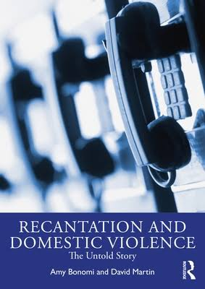
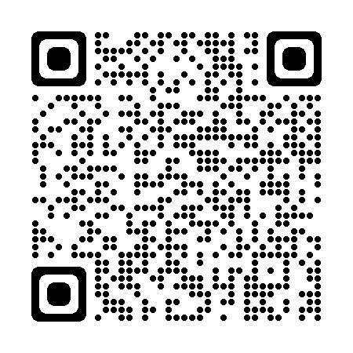
Recantation and Domestic Violence: The Untold Story Amy Bonomi, PhD, MPH

Slide 2
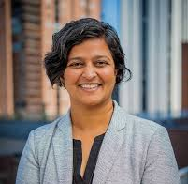
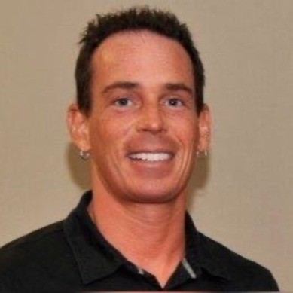


My Research Team from The Ohio State University
Rashmi Gangamma, PhD, LMFT
Christopher Locke, PhD, MSW
Heather Katafiasz, PhD, LMFT

Slide 3
Background
For domestic violence (DV) cases reaching the court system, 80% involve victims who recant or refuse prosecution (Meier, 2006)
Victims who recant are sometimes seen as less credible and “exhausting resources”
Research shows that victims who recant are weighing many scenarios:
Threat of future violence (the majority experience severe abuse, including strangulation)
Emotional connection/love for their abuser
Financial connection
Concerns for their children, pets, and other loved ones
Distrust of the criminal justice system

Slide 4
A Few Limitations of Prior Research
Derived from case files & victim statements, which give only part of the picture
Recording bias
Recall bias

Slide 5
Addressing Limitations
What would be revealed about recantation processes if we went directly into the source: listening to phone calls between abusers and victims during the pre-prosecution period?
Is the abuser (only) threatening the victim to influence her to recant? Or using other strategies?
Are there systemic/intimacy issues within couples associated with recantation?

Slide 6
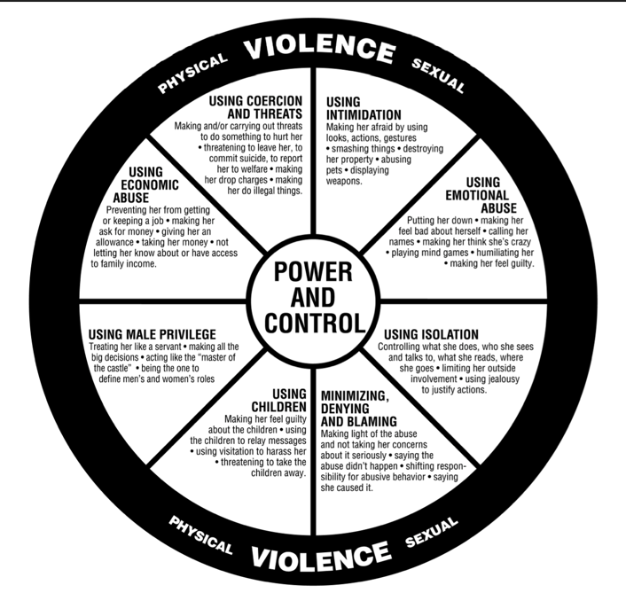
Our Theoretical Backdrop
Threats/Coercion?
Family Systems & Attachment?
Family systems → rules that define usual behaviors & patterns of interaction related to intimacy (closeness/separateness)
When there is a “crisis” & usual behaviors/patterns are disrupted, the family will do everything it can to restore the usual behaviors/patterns (even if they’re “unhealthy”!)
Jail is a “crisis” → recantation restores usual patterns & keeps the family “intact” where opportunities for working out intimacy (closeness/separateness) are born repeatedly

Slide 7
JAIL
(“Crisis”)
Threatened relational bond/family system
Alone
Family system/patterns not intact Few opportunities for “working it out”
Remind each other what’s at stake if he stays behind bars (the family system is broken, they will never see each other)
RECANT
More violence to solve intimacy needs
Restore family system and romantic bond

Slide 8
Importance of Abuser’s COERCIVE POWER
Recantation as a systemic process does not ignore the abuser’s coercive power
Rather, it may help to explain it …!
Knowing victim’s fear of being alone, abuser uses manipulation to trigger that fear to restore the family “system”

Slide 9
Objectives Today
1) To describe what occurred during phone/jail calls between the victim & abuser in influencing recantation:
What the abuser is saying
How he is saying it
How the victim responds
2) To describe how the abuser uses other people (friends, family, children) and/or other modalities (e.g., text messages) to influence recantation
3) To share professional applications (interwoven throughout)

Slide 10
Objective 1: What Occurs During Jail Calls to Influence Recantation Bonomi, A.E., Gangamma. R., Locke, C.R., Katafiasz, H., Martin, D. (2011) “Meet me at the hill where we used to park:” Interpersonal processes associated with victim recantation. Social Science and Medicine, 73: pp. 1054-1061.

Slide 11
Our Sample: 17 Couples
Detained male abuser accused of felony-level violence (all involved strangulation) & female victim
Audio-taped telephone conversations made from jail
Multiple conversations for each couple (avg., 30-192 minutes)
Subjects knew they were being recorded through automated message
State v. Modica: 164 Wash.2d. 186 P. 3d 1062, Wash. July 10, 2008 (NO. 79767-6).

Slide 12
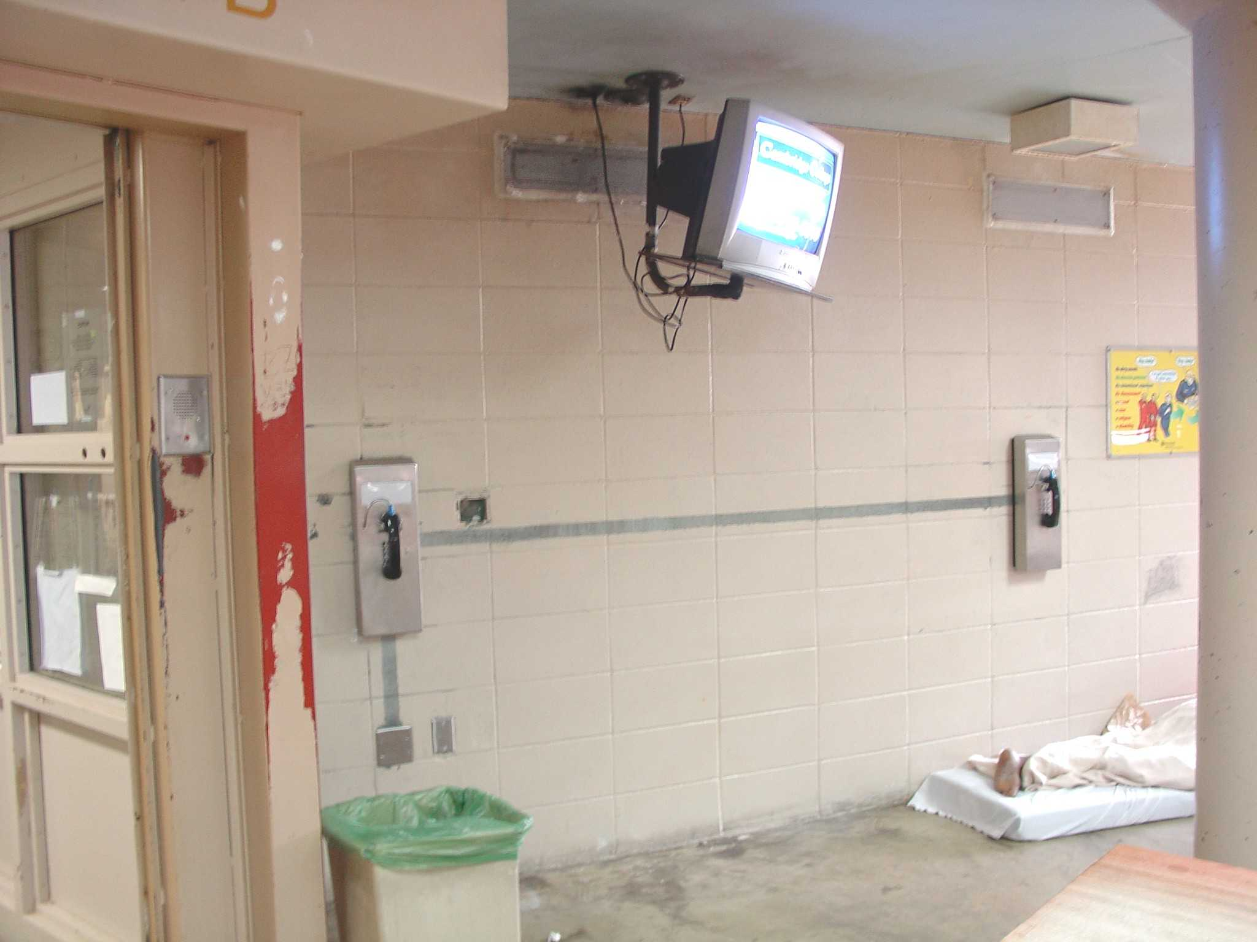
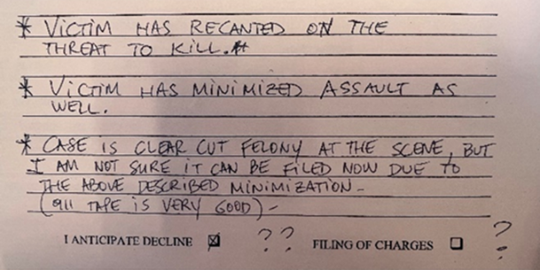
Circa 2005: Seattle/King County Detention Center Sam Villa & The First Recorded Jail Calls
Notes:
DAVID MARTIN

Slide 13
Jail Call Analysis: Procedures
Jul 09-
Oct 09
AB & RG wrote narratives for 10 couples on recantation processes
Sept 09-
Nov 10
AB, RG, HK presented at conferences to test credibility of findings
Sept 10-
Jun 11
Theoretical framework constructed & tested by examining data from original 10 couples + 7 new couples
Jan 09-
Jul 09
Transcribed jail calls & met weekly to discuss themes
Oct 08-
Dec 08
AB, RG, CL, HK met weekly to listen to jail calls, compiled notes for 10 couples

Slide 14
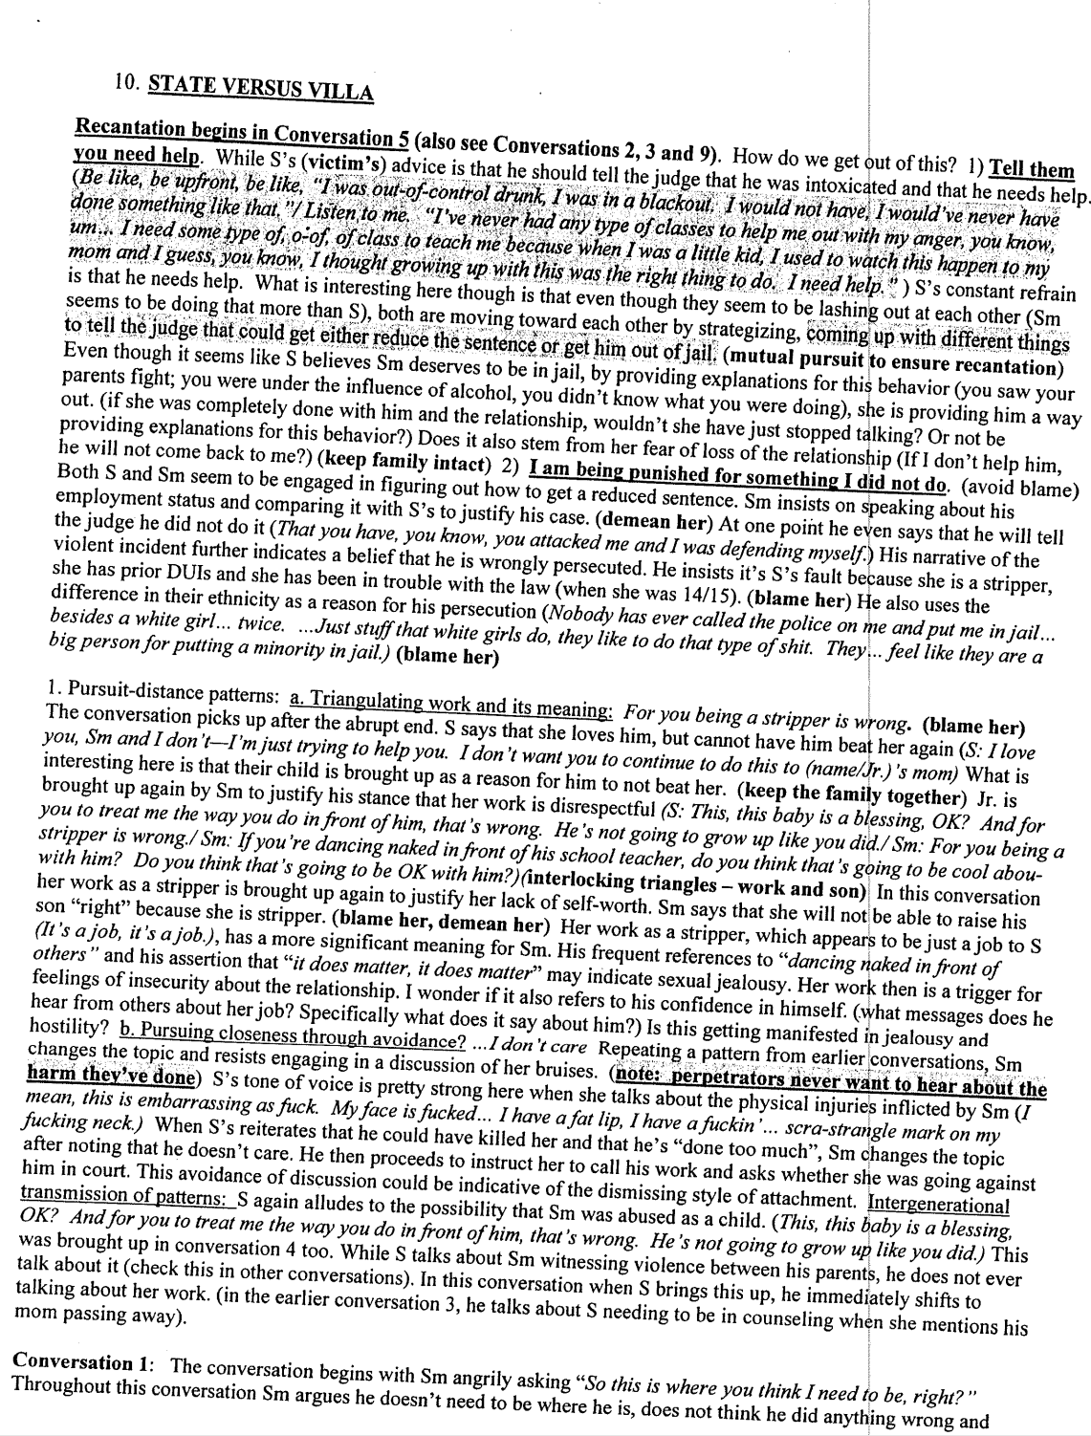
What is a Narrative Summary & What Were We Listening For?
Narrative summaries were written for every jail call for 10 couples, which allowed us to keep free-flowing conversational narrative intact while identifying themes
Used constructivist grounded theory to acknowledge two major orientations that could be interacting in recantation:
Coercive control
Intimacy/attachment needs
Love/care for each other
Fear of being alone
Desire to keep the family intact
Hope/desire for a future together
Notes:
AMY BONOMI

Slide 15
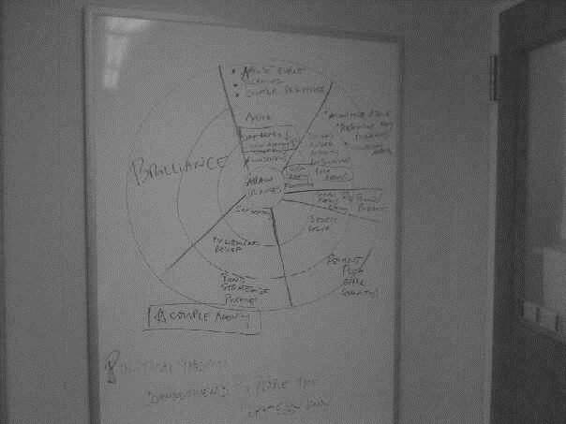
From the Narrative Summaries:
Constructed a conceptual model & tested the model against calls from an additional 7 couples
Result: the exact same patterns were present
Sept 2010: The Ohio State University
Notes:
AMY BONOMI

Slide 16
Results

Slide 17
1
Couple discusses the abuse event / mutual blame & resistance of each other’s accounts / V’s agency is “up”
Emotions:
Anger, blame, regret
4:
P. asks/instructs V. to recant & she complies / instructions are reinforced by sympathy appeals & minimization
E: Relief, anger,
sadness
2:
P. minimizes the abuse to lessen its severity / V’s agency erodes
P. uses sympathy appeals to become the “victim” / V. soothes P.
E: Anger, sadness,
guilt, regret
3:
Couple bonds over
images of life alone, love, memories & dreams / position themselves against others who “don’t understand them”
E: Sadness , regret, relief to connect over “common ground”
5:
Construct recantation plan by redefining the abuse to protect P., blaming the State, & giving each other instructions /
Couple’s agency is “up”
E: Relief , excitement, hope
Five-Stage Model
Citation: Bonomi, A. E., Gangamma, R., Locke, C., Katafiasz, H., & Martin, D. (2011). “Meet me at the hill where we used to park”: Interpersonal processes associated with victim recantation. Social Science & Medicine, 73, 1054–1061.
5 Stages depict how couples typically moved through the jail calls
Stages 1-5 are not always sequential
Couples can cycle through all 5 stages multiple times in a single jail call
Not all 5 stages need to be present for this to “work”
Notes:
AMY BONOMI

Slide 18
1
Couple discusses the abuse event / mutual blame & resistance of each other’s accounts / V’s agency is “up”
Emotions:
Anger, blame, regret
4:
P. asks/instructs V. to recant & she complies / instructions are reinforced by sympathy appeals & minimization
E: Relief, anger,
sadness
2:
P. minimizes the abuse to lessen its severity / V’s agency erodes
P. uses sympathy appeals to become the “victim” / V. soothes P.
E: Anger, sadness,
guilt, regret
3:
Couple bonds over
images of life alone, love, memories & dreams / position themselves against others who “don’t understand them”
E: Sadness , regret, relief to connect over “common ground”
5:
Construct recantation plan by redefining the abuse to protect P., blaming the State, & giving each other instructions /
Couple’s agency is “up”
E: Relief , excitement, hope
Stage 1:
Argument over what happened during the abuse event.
Resistance of each other’s accounts.
Notes:
AMY BONOMI

Slide 19

Discussing the Abuse Event
V: Why are you constantly beating on me, though?
P: I’m not constantly beating on you … you, you don’t understand that you beat on me with words and I can’t defend myself …
V: With words, but I don’t hit you …
P: Hit me, you hit me so fuckin’ hard mentally, I’m a very fragile person … mentally
V: I would, I would rather be verbally attacked …
P: I would never want to be verbally attacked in my state, it’s always a defense and then me taking it to the point where you get my level going over the flipside and I lose it like the Incredible Hulk …
Notes:
AMY BONOMI

Slide 20
1
Couple discusses the abuse event / mutual blame & resistance of each other’s accounts / V’s agency is “up”
Emotions:
Anger, blame, regret
4:
P. asks/instructs V. to recant & she complies / instructions are reinforced by sympathy appeals & minimization
E: Relief, anger,
sadness
2:
P. minimizes the abuse to lessen its severity / V’s agency erodes
P. uses sympathy appeals to become the “victim” / V. soothes P.
E: Anger, sadness,
guilt, regret
3:
Couple bonds over
images of life alone, love, memories & dreams / position themselves against others who “don’t understand them”
E: Sadness , regret, relief to connect over “common ground”
5:
Construct recantation plan by redefining the abuse to protect P., blaming the State, & giving each other instructions /
Couple’s agency is “up”
E: Relief , excitement, hope
Stage 2:
P. minimizes the abuse to “lessen its severity” / V’s agency erodes
P. uses sympathy appeals to become “the victim”/ V. soothes P.
Notes:
DAVID MARTIN

Slide 21
Sympathy Appeals: “Suffering” from Jail, Mental Illness,
Life without Victim
Notes:
DAVID MARTIN

Slide 22
1
Couple discusses the abuse event / mutual blame & resistance of each other’s accounts / V’s agency is “up”
Emotions:
Anger, blame, regret
4:
P. asks/instructs V. to recant & she complies / instructions are reinforced by sympathy appeals & minimization
E: Relief, anger,
sadness
2:
P. minimizes the abuse to lessen its severity / V’s agency erodes
P. uses sympathy appeals to become the “victim” / V. soothes P.
E: Anger, sadness,
guilt, regret
3:
Couple bonds over
images of life alone, love, memories & dreams / position themselves against others who “don’t understand them”
E: Sadness , regret, relief to connect over “common ground”
5:
Construct recantation plan by redefining the abuse to protect P., blaming the State, & giving each other instructions /
Couple’s agency is “up”
E: Relief , excitement, hope
Stage 3:
Couple invokes images of life alone
Bond over love, dreams & memories
Position themselves against others who “don’t understand them” → this strengthened their emotional/intimacy bond
Notes:
AMY BONOMI

Slide 23
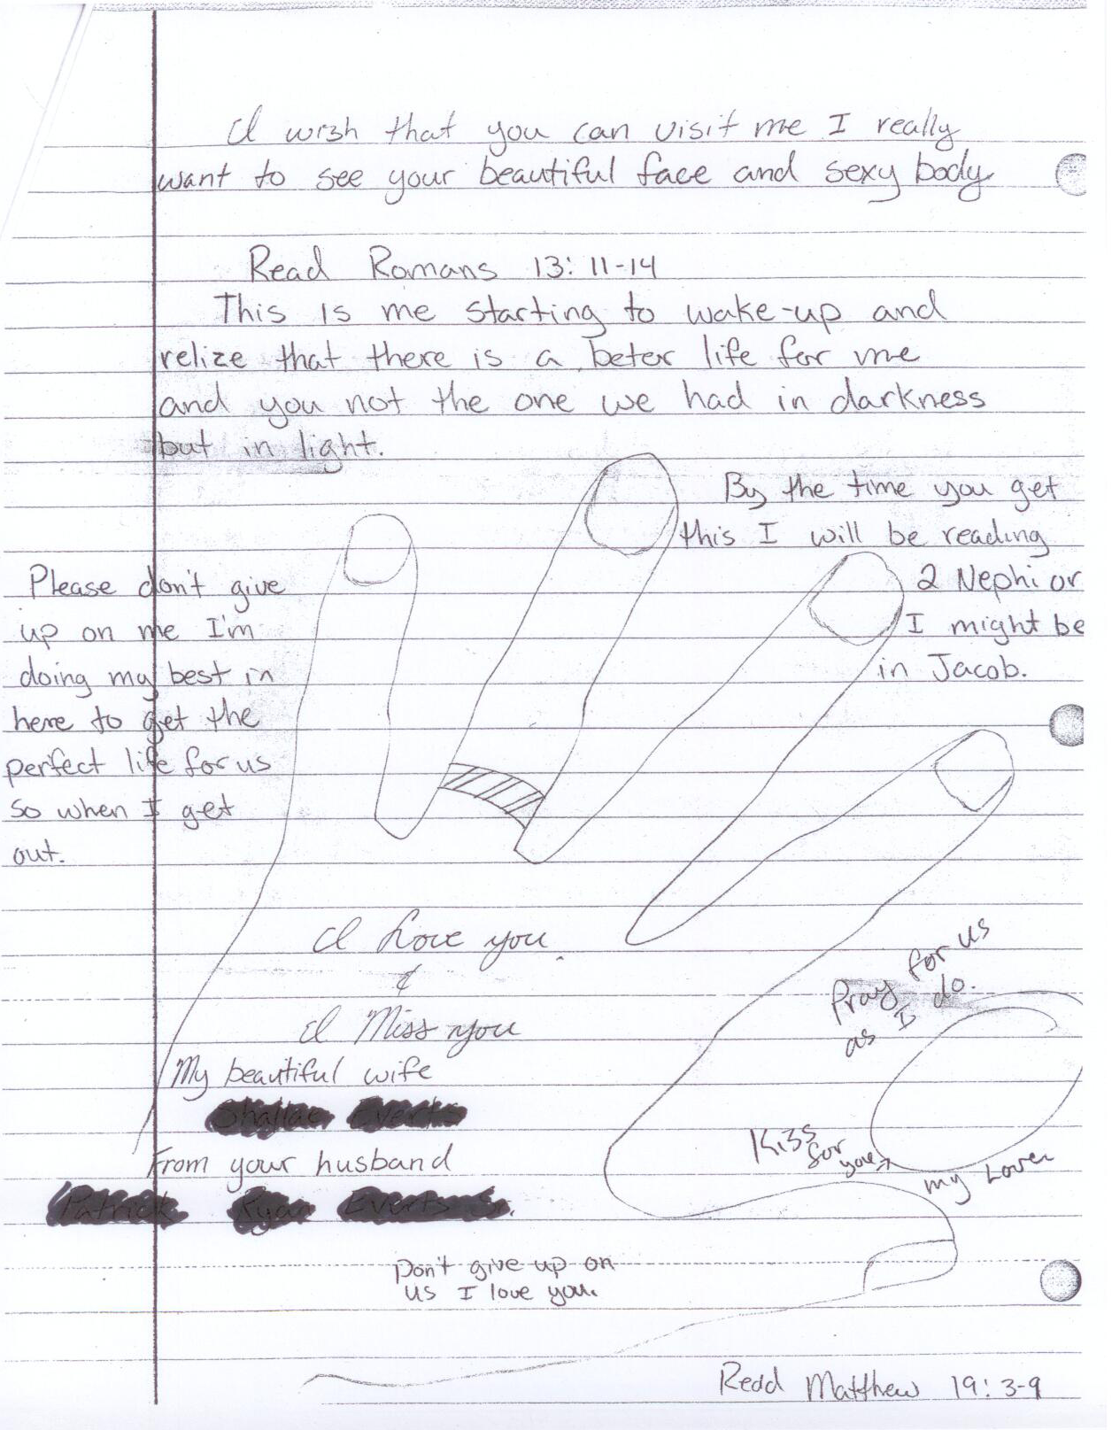
Notes:
AMY BONOMI

Slide 24
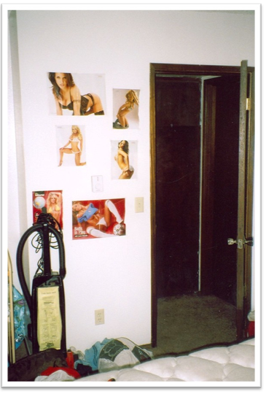
“I love you” was frequently juxtaposed with underlying:
Emotional abuse
Sexual abuse
Intimidation

Slide 25
1
Couple discusses the abuse event / mutual blame & resistance of each other’s accounts / V’s agency is “up”
Emotions:
Anger, blame, regret
4:
P. asks/instructs V. to recant & she complies / instructions are reinforced by sympathy appeals & minimization
E: Relief, anger,
sadness
2:
P. minimizes the abuse to lessen its severity / V’s agency erodes
P. uses sympathy appeals to become the “victim” / V. soothes P.
E: Anger, sadness,
guilt, regret
3:
Couple bonds over
images of life alone, love, memories & dreams / position themselves against others who “don’t understand them”
E: Sadness , regret, relief to connect over “common ground”
5:
Construct recantation plan by redefining the abuse to protect P., blaming the State, & giving each other instructions /
Couple’s agency is “up”
E: Relief , excitement, hope
Stage 4:
P. asks V. to recant
V. complies
P’s reinforces instructions with sympathy appeals & minimization
Notes:
AMY BONOMI

Slide 26
Ask Her to Recant
P: Oh my god, I love you … I haven’t been able to call you [crying] … Alright I gotta’ tell you somethin’ … um, I’m goin’ to the Supreme Court, but you gotta be there … you gotta’ sit up front and you gotta’ tell em that … what you wrote on, in the police report was a lie, that you’re just mad at me ‘cause you thought I was cheatin’ on you with your cousin. If you say that--
V: [Laughs] Okay.
P: If you say that, they’ll automatically let me go.
V: Okay.
P: Alright?
V: Uh-huh.
P: You know I love you? … Cause like, you know, but they might give you five or ten days, but that’s better than me doing sixty to ninety days.
V: Me?!
P: Yeah, but, babe, that’s better than me doing sixty to ninety days … they probably give you five days for filing a false police report, that’s it.
V: I don’t want to go to jail for five days.
P: Babe, I just spent five days in the hole. You can’t do five days for me?
Notes:
AMY BONOMI

Slide 27
1
Couple discusses the abuse event / mutual blame & resistance of each other’s accounts / V’s agency is “up”
Emotions:
Anger, blame, regret
4:
P. asks/instructs V. to recant & she complies / instructions are reinforced by sympathy appeals & minimization
E: Relief, anger,
sadness
2:
P. minimizes the abuse to lessen its severity / V’s agency erodes
P. uses sympathy appeals to become the “victim” / V. soothes P.
E: Anger, sadness,
guilt, regret
3:
Couple bonds over
images of life alone, love, memories & dreams / position themselves against others who “don’t understand them”
E: Sadness , regret, relief to connect over “common ground”
5:
Construct recantation plan by redefining the abuse to protect P., blaming the State, & giving each other instructions /
Couple’s agency is “up”
E: Relief , excitement, hope
Stage 5:
Couple constructs plan:
Re-define the abuse to protect P.
Blame the State
Give each other instructions
Notes:
DAVID MARTIN

Slide 28
Give Each Other Instructions
P: I will see what the judge has to say and I’m gonna say what I have to say but pretty much I’m, I’m going to stick with my story … I, I didn’t even touch you …
V: I wouldn’t do that because then you’re lying … be up front, be like “I was out of control drunk, I was in a blackout. I would normally, I would’ve never done something like that …”
P: And that I, I need anger management, I need to start going to classes, I need to request days off to go to anger management? NO!
V: But you need to tell the judge that you do need (anger management) … so they you the fuck out of there … otherwise they’re going to keep you in there …
Notes:
DAVID MARTIN

Slide 29
Summary
Direct threats rarely used to influence victims (although the underlying threat of future violence was there)
Recantation influenced by a combination of:
Coercion—sympathy appeals (“the tipping point”), minimization of the abuse, requests to recant
Couple bonding over ideas of life alone, love, dreams & memories
Constructing the recantation plan included:
Re-defining the abuse to protect the abuser
Blaming the State
Giving each other instructions
Notes:
AMY BONOMI

Slide 30
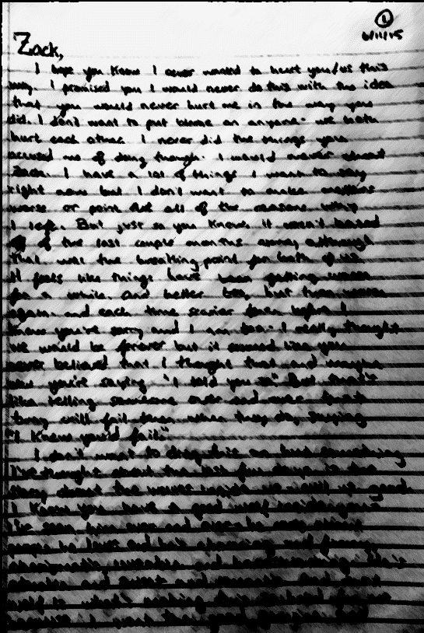
Professional Applications
Rather than lean away from recanting victims, we must lean in
Must acknowledge the coercive dynamic (she’s being controlled), but also underlying intimacy needs (e.g., love/care, fear of being alone)
The latter acknowledges the needs/desires of the victim
Notes:
AMY BONOMI

Slide 31
Through the second-by-second analysis of the jail calls, we advanced an understanding of:
Coercive dynamic
Intimacy needs/desires

Slide 32
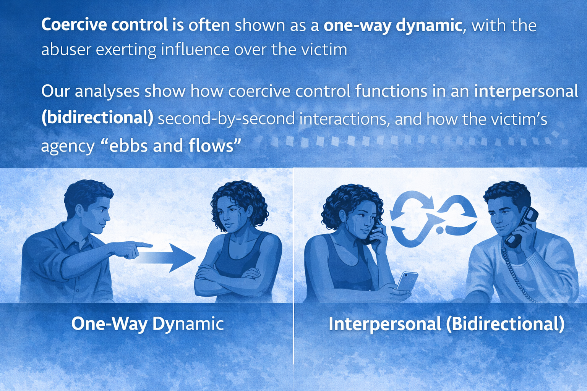
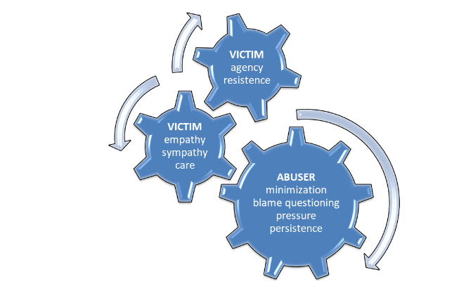
Relation to Coercive Control
Coercive control is often shown as a one-way dynamic, with the abuser exerting influence over the victim
Our analyses show how coercive control functions in an interpersonal (bidirectional) second-by-second interactions, and how the victim’s agency “ebbs and flows”

Slide 33
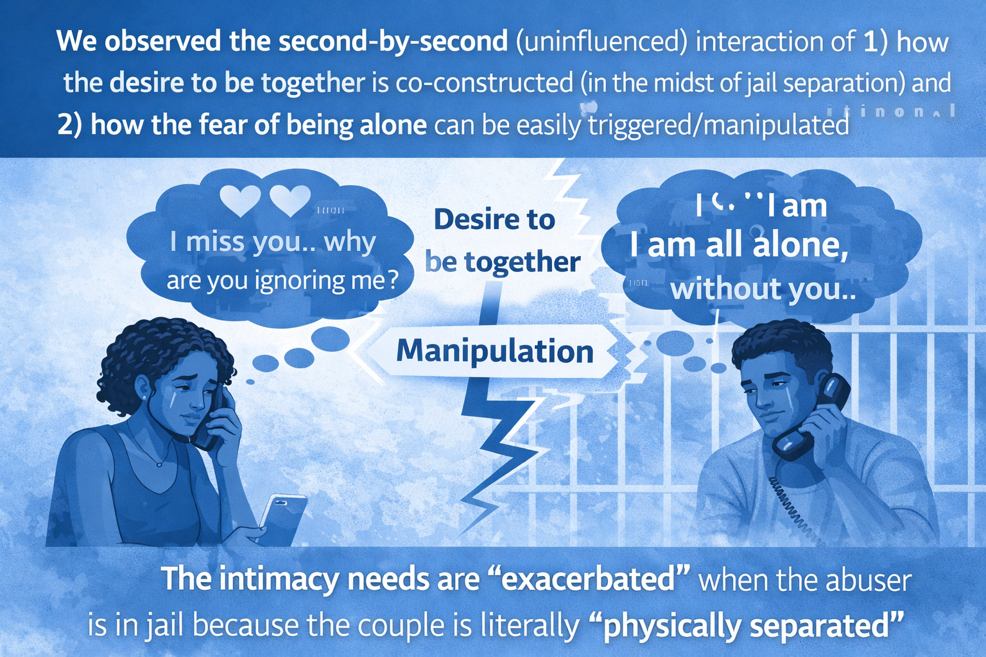
Intimacy Needs
We observed the second-by-second (uninfluenced) interaction of 1) how the desire to be together is co-constructed (in the midst of jail separation) and 2) how the fear of being alone can be easily triggered/manipulated
The intimacy needs are “exacerbated” when the abuser is in jail because the couple is literally “physically separated”

Slide 34
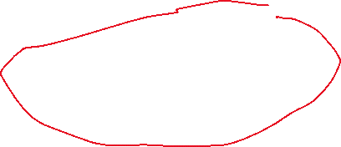

JAIL
(“Crisis”)
Threatened relational bond/family system
Alone
Family system/patterns not intact Few opportunities for “working it out”
Remind each other what’s at stake if he stays behind bars (the family system is broken, they will never see each other)
What if we saw recantation as a “crisis?” A signal of an especially dangerous abuser? How might it change how “systems” respond?
RECANT
More violence to solve intimacy needs
Restore family system and romantic bond

Slide 35
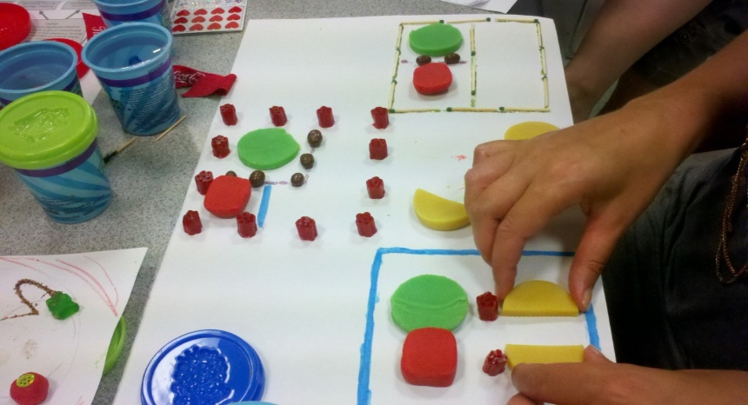
Professional Applications
1
Couple discusses the abuse event / mutual blame & resistance of each other’s accounts / V’s agency is “up”
Emotions:
Anger, blame, regret
4:
P. asks/instructs V. to recant & she complies / instructions are reinforced by sympathy appeals & minimization
E: Relief, anger,
sadness
2:
P. minimizes the abuse to lessen its severity / V’s agency erodes
P. uses sympathy appeals to become the “victim” / V. soothes P.
E: Anger, sadness,
guilt, regret
3:
Couple bonds over
images of life alone, love, memories & dreams / position themselves against others who “don’t understand them”
E: Sadness , regret, relief to connect over “common ground”
5:
Construct recantation plan by redefining the abuse to protect P., blaming the State, & giving each other instructions /
Couple’s agency is “up”
E: Relief , excitement, hope
Prosecution
Expert Testimony
Trainings/Education
Victim Advocacy
Victim Feedback
Five-Stage Model makes them feel they’re not alone
Others have gone through this, too
Helps them prepare for the tactics
Notes:
AMY BONOMI

Slide 36
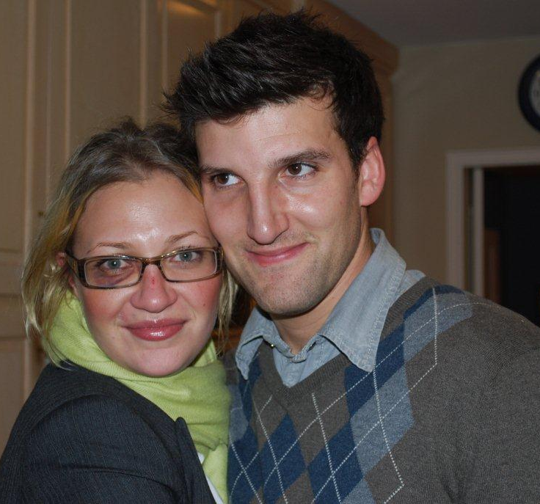
Objective 2: Extending The Five-Stage Model: How Do Abusers Involve Third Parties to Influence Victim Recantation? Bonomi AE, Martin D. Jail calls: What do kids have to do with it? Journal of Family Violence, 2018, 33(2): 99–102. Bonomi AE, Martin D. Domestic abusers: expert triangulators, new victim advocacy models to buffer against it. Journal of Family Violence 2020.

Slide 37
Abuser Uses Children to Influence Recantation

Slide 38
Abuser Triangulates Child Against the Victim: It’s “Us” vs. “Her”
Abuser severely beat his wife at a nightclub (breaking her nose) because she was “ruining his chance to have fun.” [STAGE 1&2: BLAME] While awaiting trial, the abuser tampered with the victim from jail, including triangulating their 5-year-old child.
During one call, shortly after implicating the victim (“You sat there and wanted me to do that [break your nose]”) [STAGE 1&2: BLAME], the abuser asked to talk to the couple’s child. When the child got on the phone, the abuser intimidated the child and placed blame for the abuse back on the victim: “Your mom is mean and evil. Tell her I said that. Ask your mom why she hates me. Ask her why she don’t love me, why she keep puttin’ me in jail.” [STAGE 2: SYMPATHY APPEAL]
The child repeated the questions to the victim, and the victim refused to give the phone back to her child. This prompted the abuser to intimidate the victim repeatedly, “Can I talk to my [child]?!” He further intimidated the victim by threatening suicide (e.g., “Why you wanna’ kick a motherfucker while he’s down, though? You’re making me go crazy … you wanna’ seek a motherfucker suicidal?”). [STAGE 2: SYMPATHY APPEAL] In response, the victim agreed to try to get the abuser out of jail.

Slide 39
Abuser Uses Friends to Convey Messages

Slide 40

Abuser: Dog I, its, dog its hella important that I talk to her dog. Can you hear me?
FRIEND: Yeah. You want me to pass her that number or what do you want me tell her?
Abuser: Dog I want you to show up to her f****n' work man. And beat that bitch in her f****n' face, in her f****n‘ rat. Jesus Christ dog give her that f****n’ number dog and tell her to f****n sit the f**k down and shut up. Can you do that?

Slide 41
Abuser: That’s the f*** she’s talking about.
FRIEND: And if she don’t show up all three of them bulls***s will drop?
Abuser: All that s**t goes away.
FRIEND: Man, and you get out this weekend if…if it happens?
Abuser: Well I’m…no it’s gonna take a week. Cause look, the trial date after that if she doesn’t come for like a week, then it all goes away.

Slide 42
Abuser Uses a Combination of Modalities (Texting, Photos)
Bonomi AE, Martin D. Domestic abusers: expert triangulators, new victim advocacy models to buffer against it. Journal of Family Violence 2020.

Slide 43
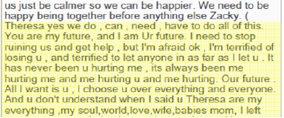
Stage 2: Sympathy Appeals
Stage 3: Image of a Solid Connection, Promises of a Better Life, Referring to Victims as “BABIES MOM”

Slide 44
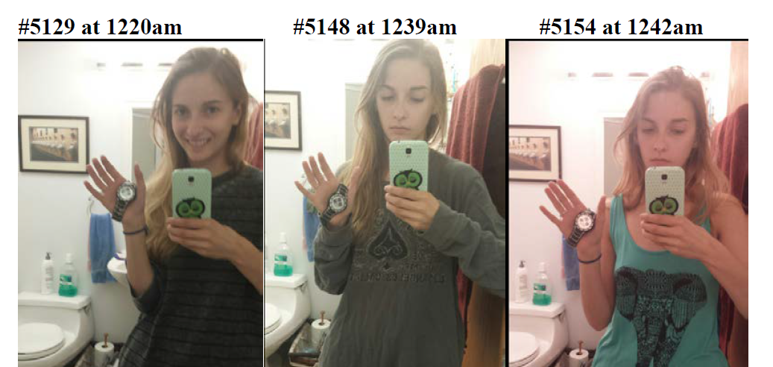
Phone Calls Are Supplemented with Pressuring the Victim to Send Photos Proving She’s Not with Another Man
Notes:
D DEMANDS PROOF SHE IS NOT WITH ANOTHER MAN. HE DOES NOT BELIEVE HER AND REPEATEDLY DEMANDS PHOTO DOCUMENTATION. PHOTOS BACK FROM VICTIM IN RESPONSE. A SIGN OF CONTROL AND INTENSE JEALOUSY THAT IS SHAPED AS A FORM OF LOVE/CARE
CALLS HER FROM JAIL ON A DIFFERENT CHARGE, DEMANDS TO KNOW WHY SHE IS OUT AND NOT HOME WHEN SHE SAID, DEMANDS TO KNOW WHY THERE ARE MEN AT THE RESTAURANT AND IS SHE ON A DATE, SAYS HE NOW IS GOING TO REFUSE BAIL AND STAY IN JAIL, NOT VISIT IN ORDER TO PUNISH HER

Slide 45
Are Direct Threats Ever Used?

Slide 46
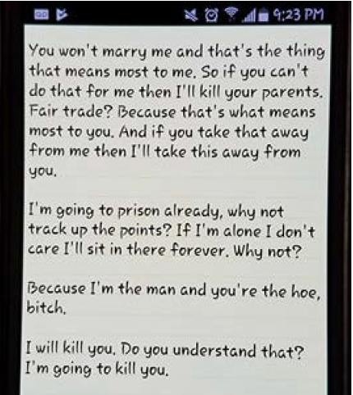
Direct Threats
Notes:
USING OTHERS THREATENING TO KILL HER PARENTS
RECORDING HIS WORDS TO HER IN REAL TIME DURING CONVERSATION.

Slide 47
Professional Intervention: The Power of Advocates in Interrupting
Bonomi AE, Martin D. Domestic abusers: expert triangulators, new victim advocacy models to buffer against it. Journal of Family Violence 2020.

Slide 48
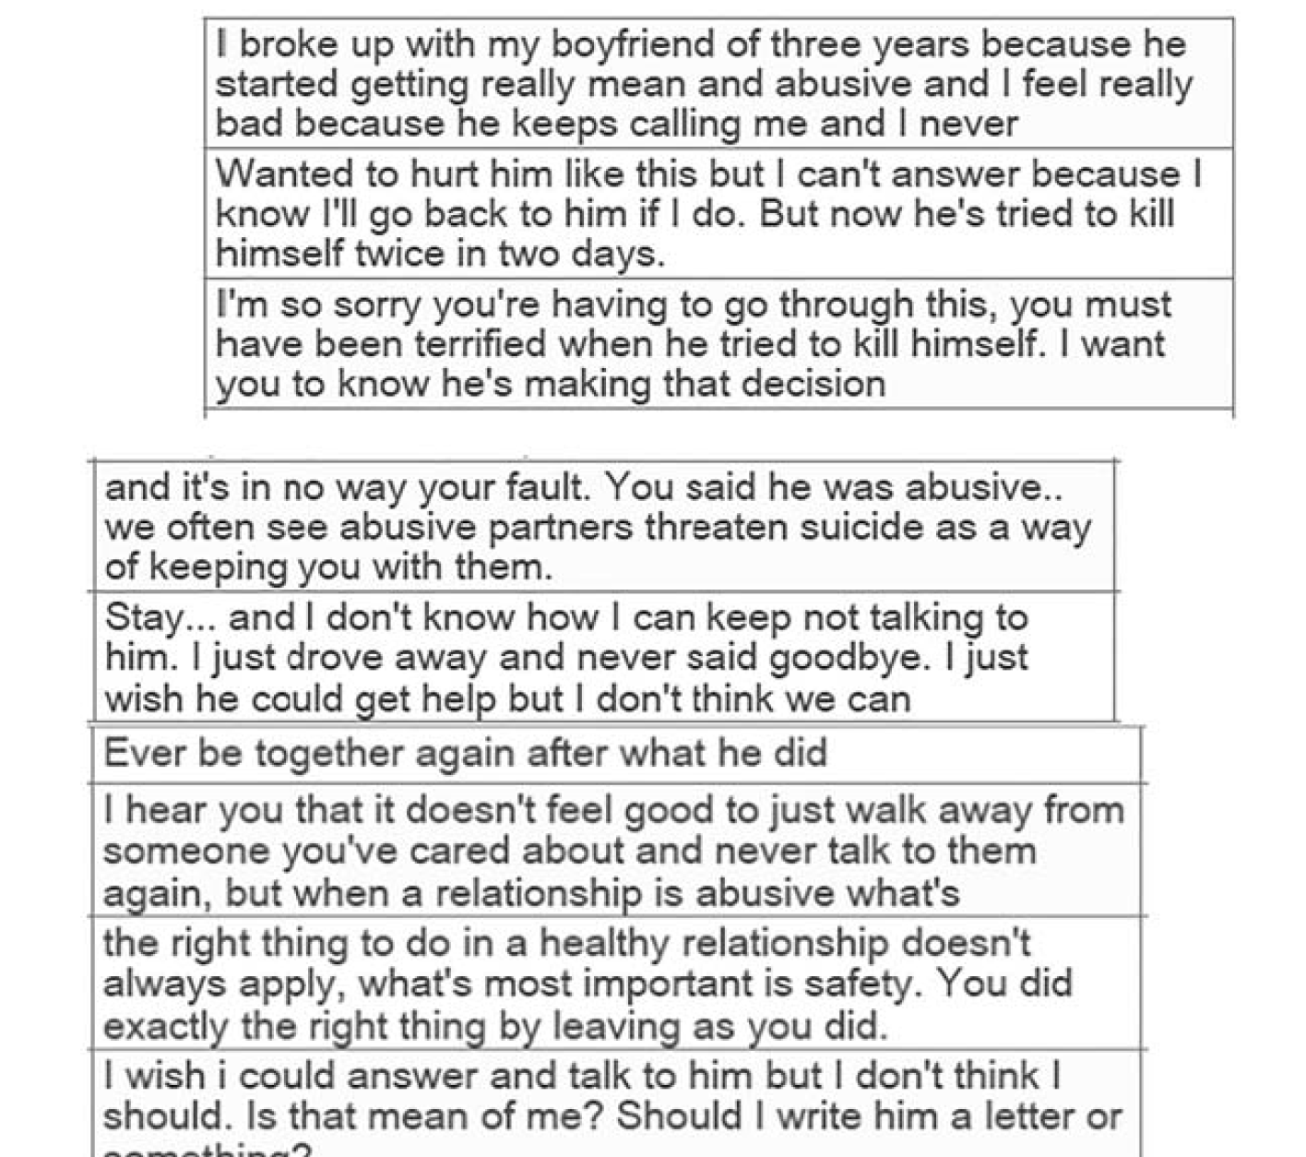
Advocate Intervention
1) Apologizing that the victim is having the experience of
Abuse
2) Acknowledging how frightened the victim might be
3) Reminding the victim that the abuser’s manipulation/
triangulation is not her fault. In this instance, the abuser’s
manipulation is telling the victim he’s going to kill himself,
which is an attempt to forge closeness with
(triangulate) the victim
4) Underscoring the victim’s experience with the reality that
these are common dynamics observed in abusers. In this
particular scenario, the advocate underscores that it is
common for abusers to use suicide threats as a means to
triangulate (forge closeness) with the victim
5) Reminding the victim that what might apply in a healthy
relationship may not apply in a relationship where abuse
is occurring.
6) Validating the victim’s decision to remove herself from
the immediate abuse by leaving when the abuser threatened
suicide.

Slide 49
Objective 3: Professional Applications (Again)
1
Couple discusses the abuse event / mutual blame & resistance of each other’s accounts / V’s agency is “up”
Emotions:
Anger, blame, regret
4:
P. asks/instructs V. to recant & she complies / instructions are reinforced by sympathy appeals & minimization
E: Relief, anger,
sadness
2:
P. minimizes the abuse to lessen its severity / V’s agency erodes
P. uses sympathy appeals to become the “victim” / V. soothes P.
E: Anger, sadness,
guilt, regret
3:
Couple bonds over
images of life alone, love, memories & dreams / position themselves against others who “don’t understand them”
E: Sadness , regret, relief to connect over “common ground”
5:
Construct recantation plan by redefining the abuse to protect P., blaming the State, & giving each other instructions /
Couple’s agency is “up”
E: Relief , excitement, hope
Prosecution
Expert Testimony
Trainings/Education
Victim Advocacy
Victim Feedback
Five-Stage Model makes them feel they’re not alone
Others have gone through this, too
Helps them prepare for the tactics
Notes:
AMY BONOMI

Slide 50
Publications Using the Jail Calls
Bonomi, A. E., Gangamma, R., Locke, C., Katafiasz, H., & Martin, D. (2011). “Meet me at the hill where we used to park”: Interpersonal processes associated with victim recantation. Social Science & Medicine, 73, 1054–1061.
Bonomi, A. E., & Martin, D. (2018). Jail calls: What do kids have to do with it? Journal of Family Violence, 33(2), 99–102.
Bonomi, A. E., & Martin, D. (2020). Domestic abusers: Expert triangulators, new victim advocacy models to buffer against it. Journal of Family Violence.
Bonomi, A. E., & Martin, D. (2019). Witness tampering involving children and the use of civil legal aid to buffer against it. Domestic Violence Report, 24(2).
Bonomi, A. E., & Martin, D. (2023). Recant and domestic violence: The untold story. Taylor & Francis.
Gangamma, R., & Bonomi, A. E. (2010, October 7–8). Developing a systemic interpretation of couple-level data [Oral presentation]. Advances in Qualitative Methods Conference, Vancouver, British Columbia, Canada.
Nemeth, J., Bonomi, A. E., Lee, M., & Ludwin, J. (2012). Sexual infidelity as trigger for intimate partner violence. Journal of Women’s Health, 21(9), 942–949.

