Slide 1
You can’t help me if you don’t see me: supporting male Survivors
Dr. Otis McGresham
Assistant Director for Prevention

Slide 2
Agenda
Overview of Male Sexual Assault
Barriers
Impact on Help Seeking
Tips & Takeaways

Slide 3
Overview of Male Sexual Assault

Slide 4
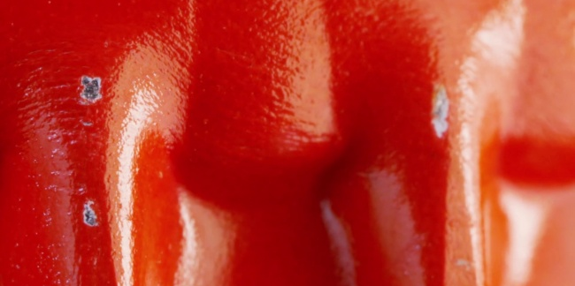
Identify this Object

Slide 6
Adult Male Sexual victimization
How you define it will shape what you are looking for.
What you are looking for will determine what you see.

Slide 7
Rates of Victimization
5% – 10% percent of all sexual assaults per year
38% - 48% of male college students
59 % of the male prison inmate population
23.6% of males experience some form of sexual violence in their lifetime
1 in 33 men experience attempted or successful rape
1 in 5 men experience sexual assault

Slide 8
Sexual Assault, Sexual Victimization, Rape, or Something Else?
World Health Organization
Sexual Assault - Any sexual act, attempt to obtain a sexual act, unwanted sexual comments or advances, or acts to traffic, or otherwise directed, against a person’s sexuality using coercions, by any person regardless of their relationship to the victim, in any setting, including but not limited to home or work.

Slide 9
Sexual Assault, Sexual Victimization, Rape, or Something Else?
United States Department of Justice
Sexual Assault - a wide range of victimizations, separate form rape or attempted rape. These crimes include attacks or attempted attacks generally involving unwanted sexual contact between victim and offender. Sexual assaults may or may not involve force and include such things as grabbing or fondling. Sexual assault also includes verbal threats.
Rape – Forced sexual intercourse including both psychological coercion and physical force. Forced sexual intercourse means vaginal, anal, or oral penetration by the offender(s). This category also includes incidents where the penetration is from a foreign object, such as a bottle, Includes attempted rape, male, and female victims, and both heterosexual and same sex rape. Attempted rape includes verbal threats of rape.

Slide 10
Sexual Assault, Sexual Victimization, Rape, or Something Else?
Your Organization
?

Slide 11
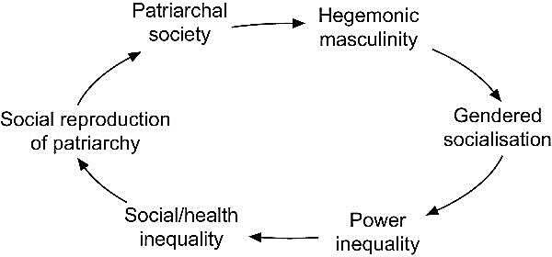
Hegemonic Masculinity
“Gender role stereotypes contribute to men’s reluctance to report acts of sexual violence and also can lead to nonexistent or nonresponsive service provision”.
Donnelly, D & Kenyon, S. (1996)

Slide 13
Gender Role Dysfunction
…the fulfillment of gender role standards can have negative consequences because the behaviors and characteristics these standards prescribe can be inherently dysfunctional…

Slide 14
Barriers
Invisibility
Rape Myths
Language
Stigma
Resources
This Photo by Unknown Author is licensed under CC BY-SA

Slide 15
Barriers
Invisibility
Rape Myths
Language
Stigma
Resources
“Although research affirms that male sexual violence is a legitimate problem its reality remains virtually invisible…The Center for Disease Control and Prevention and the Federal Bureau of Investigation found that men and women reported a similar prevalence of nonconsensual sex (women 1.270 million; men 1.267 million)”.
Thomas, J.C. & Kobel, J. (2023)

Slide 16
Barriers
Invisibility
Rape Myths
Language
Stigma
Resources
It is rare
Women cannot be perpetrators
Only happens in prison
Men do not suffer psychological consequences
Men are too strong to be forced into unwanted sex
Male victims lose their manhood
?

Slide 17
Barriers
Invisibility
Rape Myths
Language
Stigma
Resources
“Victims are hindered by whether the act fits their own a priori definition of sexual victimization”.
Thomas, J.C. & Kopel, J. (2023)

Slide 18
Barriers
Invisibility
Rape Myths
Language
Stigma
Resources
“Male victims are perceived to carry a level of blame for not resisting their attacker. Others may question how a man can achieve and maintain an erection and sexually perform if the sexual encounter is a coercive situation.”
Thomas, J.C. & Kopel, J (2023)

Slide 19
Barriers
Invisibility
Rape Myths
Language
Stigma
Resources
Misconceptions are not only prevalent among the public, college students, and law enforcement but medical trainees, crisis workers, and counselors…both male and female trainees accept some the detrimental rape biases”.
Thomas, J.C. & Kopel, J (2023)

Slide 20
“How people react to the victim’s admission is incredibly salient given that victims are acutely aware of rape myths and skepticism when disclosing and societal attitudes on how individuals should act based on their gender”.
Walfield, S. (2013)

Slide 21
One Study in GA Found
41 agencies advertising rape crisis or sexual assault services
30 of the 41 agencies participated in follow up interviews
Represented were law enforcement agencies (4), hospitals or medical facilities (10) mental health agencies (8), and community-based rape crisis centers (8)
11 indicated that they do not serve males
4 had dealt with a male victim in the past year
Total of 9 had dealt with a male victim at some time in the past.

Slide 22
Some of the interview Quotes
“What would you want to study something like that for, men can’t be raped”.
“We don’t see men, probably because so few get raped”.
“Most males that are fondled or sodomized are males that want to be sodomized. We don’t have too many that are unwontedly sodomized. If they are, they don’t come to us to report it…We just don’t see that many adult males, so that leads me to believe that there is just not a problem”.

Slide 23
Tips and takeaways: How You Can Better Support Male Survivors

Slide 24
Direct Support
See Male Survivors
Validate their Experience
Create a safe space
Listen
Ask what they need from you
Allow them to sit with their feelings and emotions
Respect survivor Autonomy

Slide 25
Indirect Support
Remove as many barriers as you can
Educate yourself and your staff
Identify resources
Change the Culture

Slide 26
Questions/Conversation

Slide 27
THANK YOU
Dr. Otis McGresham
615-875-0660
otis.mcgresham@vanderbilt.edu​
https://www.linkedin.com/in/otis-mcgresham/

Slide 28
References
DONNELLY DA, KENYON S. Honey, We Don’t Do Men: Gender Stereotypes and the Provision of Services to Sexually Assaulted Males. Journal of interpersonal violence. 1996;11(3):441-448. doi:10.1177/088626096011003009
Forsman, R. L. (2017). Prevalence of Sexual Assault Victimization Among College Men, Aged 18–24: A Review. Journal of Evidence-Informed Social Work, 14(6), 421–432. https://doiorg.proxy.library.vanderbilt.edu/10.1080/23761407.2017.1369204
McLean IA. The male victim of sexual assault. Best practice & research Clinical obstetrics & gynaecology. 2013;27(1):39-46. doi:10.1016/j.bpobgyn.2012.08.006
Sable MR, Danis F, Mauzy DL, Gallagher SK. Barriers to Reporting Sexual Assault for Women and Men: Perspectives of College Students. Journal of American college health. 2006;55(3):157-162. doi:10.3200/JACH.55.3.157-162
Thomas JCC, Kopel J. Male Victims of Sexual Assault: A Review of the Literature. Behavioral sciences. 2023;13(4):304-. doi:10.3390/bs13040304
Walfield SM. “Men Cannot Be Raped”: Correlates of Male Rape Myth Acceptance. Journal of interpersonal violence. 2021;36(13-14):6391-6417. doi:10.1177/0886260518817777

