Slide 1

Children's Exposure to Domestic Violence:
A Risk & Resilience Perspective
Megan Haselschwerdt, Ph.D.
Associate Professor, Child & Family Studies
Knoxville Coordinated Community Response, 9/28/20

Slide 2
Presentation Plan
Define domestic violence
How many youth are exposed to DV?
How are youth exposed to DV?
How does DV exposure impact development across the lifespan?
Discussion & Q/A

Slide 3
What is domestic violence
Domestic violence (DV) is the willful intimidation, physical assault, sexual assault, and/or other abusive behavior perpetrated by an intimate partner against another
Disproportionally affects women (NISVS)
  Prevalence, characteristics of violence, and short- & long-term effects
Most common, yet underreported crime in the United States
Notes:
In this presentation, I’ll largely be talking about violence and abuse perpetrated by a male partner toward a female partner.
The reasons for this is because…
But also, much of what we know about the impact of DV exposure is either without recognizing the gender of the pepertrator and/or victim, or a predominant focus on father-mother perpetrated DV
There are no studies that I am aware of that examine the impact of DV exposure in the context of same-sex relationships, such that the large body of literature on youth’s DV exposure experiences are in the context of exposure to DV perpetrated by one different gender partner (man) against another (woman)
1/4 women will experience DV in their lifetime & ….
Key risk factors include pattern of coercive control, history of strangulation, access to firearms, and unemployment

Slide 4
How many youth are exposed to DV each year?
Between 7 to 15.5 million youth are exposed to DV (McDonald et al., 2006)
  3.5-7.5 million are exposed to severe DV
6.6% versus 25% of all youth (Hamby et al., 2011; Finkelhor et al., 2009)
US $55,000 average cost to the national economy per child (Holmes et al., 2018)
  $55 billion for all DV-exposed children
Notes:
Zinzow and colleagues (2009) obtained a lifetime estimate of 9 percent in the National Survey of Adolescents–Replication (NSA–R), but their sample included only adolescents and included only violence between parents
Further, they assessed only severe forms of physical violence, so in many ways their estimate is less comparable to most national data on IPV, which typically include a wide range of acts.
Approximately 1 in 15 youth, or 6.6 percent, had been exposed to some form of physical assault between their parents in the past year. A roughly equivalent percentage, 5.7 percent, was exposed to psychological/ emotional IPV (verbal threats, punching walls, and throwing, breaking, or destroying household items) in the past year. If exposure to other forms of family violence is included, such as parental assaults on other children or assaults between teen or adult relatives in the household, then one in nine youth (11.1 percent) were exposed to physical or psychological violence in the family during the previous year.

Slide 5
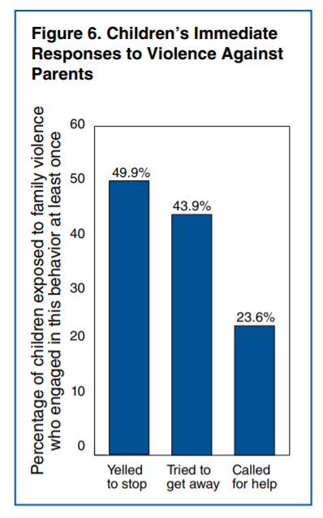
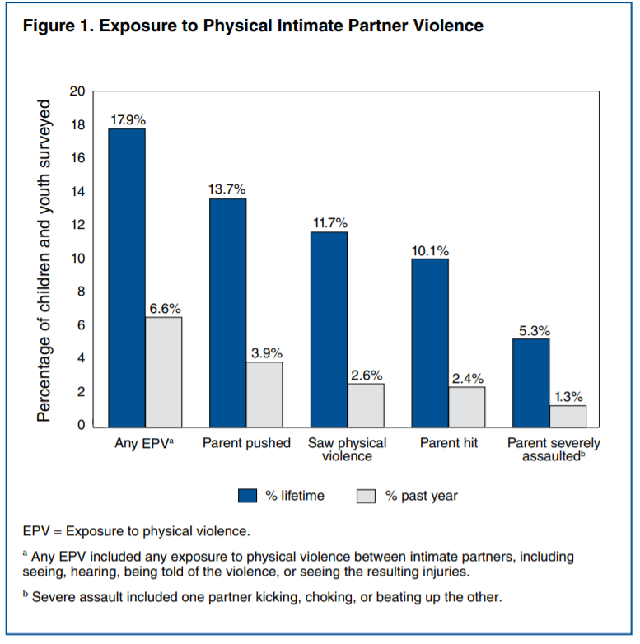
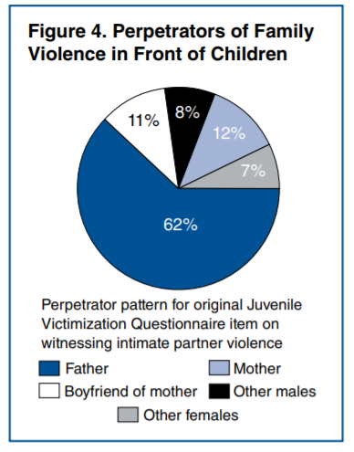
National Survey of Children’s Exposure to Violence (Hamby et al., 2011)
2011 U.S. National telephone survey of 4,503 youth (1 mo.-17 yrs.)
Notes:
28% of adolescents (14-17) reported exposure to physical DV.
Age of youth was strongly associated with DV exposure (older age means longer exposure), so if we only look at oldest group of children, we would see a higher prevalence rate of lifetime exposure.
No significant differences by age in past-year exposure to physical IPV

Slide 6
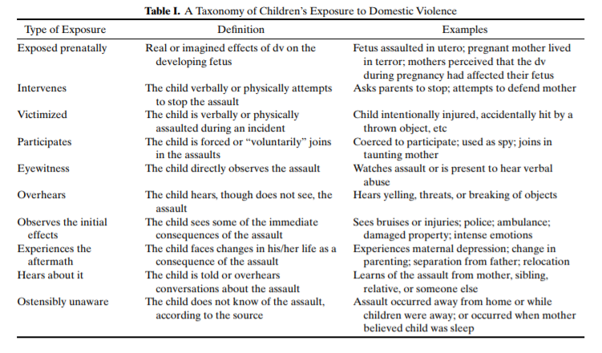
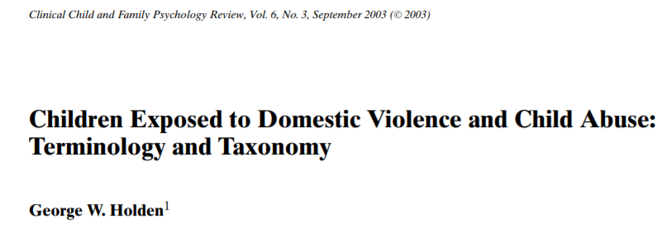
How are youth exposed to DV?
Notes:
Introduce Y’ALL Project to reference quotes

Slide 7
How are youth exposed to DV?
Notes:
For most of these next exposure types, I’m going to utilize some quotes from participants in one of my studies. This study focused on young adults who were exposed to father-mother perpetrated DV during their childhood and adolescence. I’ll tell you more about this study in a little bit, but for now, these quotes exemplify the ways in which youth could be exposed to physical violence aside from or in addition to witnessing the violence.

Slide 8
How are youth exposed to DV?
“There have been times where I had to jump into the middle of them to stop him from hitting her because he would never hit me . . . so I would always try to use myself to protect my mom from him whenever I could.” (London)
Notes:
One survey of police incidents revealed that 11 percent of calls to police were made by youth exposed to family violence (Fantuzzo et al., 1997).
In a clinical sample, more than one-half of youth had yelled at their parents during a fight or tried to get away from the fighting (Edleson, Shin, and Armendariz, 2008).
Give some context to Lisa

Slide 9
How are youth exposed to DV?
“I think I stopped [intervening] after the first 4 or 5 times because I was tired of getting thrown. My dad would like literally pick me up and throw me across the room to get me out of the way.” (Caitlin)

Slide 10
How are youth exposed to DV?

Slide 11
How are youth exposed to DV?
“She came home one morning and it was like 6am [from the family restaurant], and they started arguing or whatever. I woke up to the arguing and loud voices and all of that stuff, and then I saw my dad was just dragging my mom down the hallway… by her arm or something. But, he was telling her to stand up or whatever. But then the baseboard or whatever kind of hurt her, and she was naked because she was going to go take a shower. So she came into my room, and we got her some clothes.” (Aalyiah)
Notes:
The most immediate type of exposure, eyewitnessing, was by far the most common, accounting for 65 to 86 percent of all exposure. Other types of exposure nonetheless add significantly to the total, especially hearing but not seeing the violence.
Most youth exposed to family violence, including 90 percent of those exposed to IPV, saw the violence, as opposed to hearing it or other indirect forms of exposure
She came home one morning and it was like 6am [from the family restaurant], and they started arguing or whatever. I woke up to the arguing and loud voices and all of that stuff, and then I saw my dad was just dragging my mom down the hallway… by her arm or something. But, he was telling her to stand up or whatever. But then the baseboard or whatever kind of hurt her, and she was naked because she was going to go take a shower. So she came into my room, and we got her some clothes.

Slide 12
How are youth exposed to DV?
“I heard the glass break. But the door was shut because my mom was trying to wrap the presents in the living room. We lived in a trailer at the time, so the door to our—my sister and my room—looked out directly onto the living room, so she shut the door. I heard him start yelling and throwing things. He got mad at my mom and started throwing these snow globes that we were supposed to get for Christmas.” (Barbara)
Notes:
I think I stopped after the first 4 or 5 times because I was tired of getting thrown. My dad would like literally pick me up and throw me across the room to get me out of the way.

Slide 13
How are youth exposed to DV?
“There were times when I would be asleep and the yelling would start and wake me up . . . The yelling would always wake me up, and it’s actually affected my sleep pattern. I sleep lighter than I used to and I’m easily woken at night. I used to sleep through… I used to be able to sleep through anything, and now unless I’m really focusing on being tired and not listening in on my environment, I can’t sleep.” (Barbara)
Notes:
I think I stopped after the first 4 or 5 times because I was tired of getting thrown. My dad would like literally pick me up and throw me across the room to get me out of the way.

Slide 14
How are youth exposed to DV?
“I never directly witnessed anything. I’ve seen like bruises on her and stuff like that. And I’ve never, I’ve never asked her about it until he showed up at the store and held a gun to her head. But she didn’t know I knew about that.” (Sarah)

Slide 15
How are youth exposed to DV?
“[Administrators at the jail] wouldn’t let me see her, but they told me how to bail her out. I was like, ‘I’m a junior in high school—I don’t know how to bail people out of jail! I have to go to school tomorrow.’ And they were like, ‘Well, you can either bail her out or you can go to school, but you have to choose one.’ So I didn’t go to school.” (Taylor)

Slide 16
How are youth exposed to DV?
“My mom at the time didn’t want to expose me to [the DV], but as I’ve gotten older she will tell me stories about how he would hit her or grab her in like, the laundry room. If she wasn’t doing something he would just hit her in the laundry room – or if in public, he would grab her. Just subtly, and it would leave marks I guess. But, I’ve learned about all of this stuff post-divorce.” (Emma)

Slide 17
How are youth exposed to DV?

Slide 18
The Impact of DV Exposure Across the Lifespan
In Utero
School Age
Teen Years
Infant-Toddler
Preschool
Young Adulthood
Emotional & behavioral
Cognitive & academic
Social & relational
Physical/somatic health
Emotion regulation difficulties
Posttraumatic stress disorder symptoms
Increased risk of direct child abuse
Notes:
The developmental impact is cumulative such that earlier symptoms or behaviors build upon one another without successful interventions including specific therapy/treatments for trauma-exposed youth AND, in some instances, extensive treatments and removal of care from abusive parent/parents
There is some evidence that exposure to IPV may hinder the development of children’s emotional regulation systems thus affecting their overall ability to manage their emotions
The development of self-regulation is a prerequisite to the development of social skills that allow individuals to successfully negotiate complex social situations and to develop reciprocity and empathy, i.e. connections with others.
These problems are particularly detrimental during the preschool to school-aged years, when adherence to rules and prosocial behavior is emphasized.
PTSD: intrusive re-experiencing of events in dreams or flashbacks, hyper arousal, exaggerated startle response, emotional withdrawal
Studies seem to show that the risk of child abuse in the context of Coercive Controlling Violence is very high (Appel & Holden, 1998). However, the extent to which there is or is not a link between Situational Couple Violence and child abuse (as opposed to child hitting/slapping/shoving that does not rise to the legal threshold of abuse) is still unknown

Slide 19
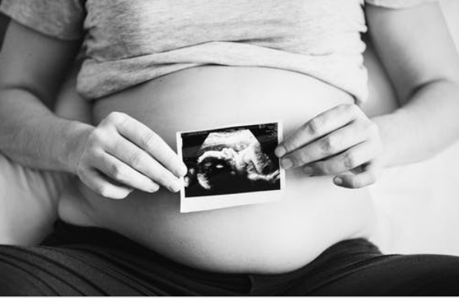
The Impact of DV Exposure Across the Lifespan
In Utero/ Pre-natal Exposure
School Age
Teen Years
Infant-Toddler
Preschool
Young Adulthood
Leading cause of maternal death during pregnancy
Greater risk for miscarriage & induced labor
Greater risk for maternal posttraumatic stress symptoms → higher levels of infant trauma symptoms
Preterm birth, low birthweight & 1-minute Apgar scores
Notes:
Lannert et al. 2014
Less likely to receive prenatal care*

Slide 20
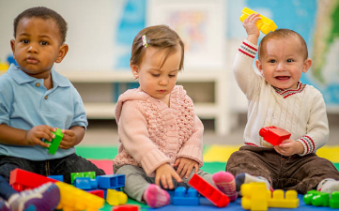
The Impact of DV Exposure Across the Lifespan
In Utero
School Age
Teen Years
Infant-Toddler
Preschool
Young Adulthood
Language and verbal deficits
Fine motor-adaptive deficits
Externalizing behavioral problems
Difficulty forming secure attachment
Insecure or avoidant attachment
Higher levels of distress
Negative impact on weight gain
Asthma
Notes:
***From a biological perspective, children’s chronic exposure to stress challenges their physiological response systems beginning in infancy, which can leave them more vulnerable to physical illness and arrest or delay their physical development
Young children, because of their dependence, are particularly vulnerable to threats aimed at their mother, particularly when the source of those threats is another caregiver
Exposure to stress during child development negatively impacts the physiology of the developing brain, particularly the hypothalamic-pituitary-adrenal-axis (HPA-axis)
DV exposure increases the odds of not meeting language, personal-social, and fine motor-adaptive milestones by age 3
Externalizing behaviors: aggression towards self and others, delinquency that is not violent (theft, drug use, lying), hyperactivity
Undercontrolled/noncompliant
Aggressive/antisocial = externalizing behaviors
Fearful/inhibited behaviors = internalizing behaviors
In so far as the behavior of the abusive male disrupts the child and mother’s sense of safety and security, and creates fright in addition to physical injury, the abuser may play a key role in the disruption of an attachment relationship.
Higher levels of distress regardless of temperament

Slide 21

The Impact of DV Exposure Across the Lifespan
In Utero
School Age
Teen Years
Infant-Toddler
Preschool
Young Adulthood
Internalizing symptoms (e.g., fearful, worry, anxious, depressive)
Less understanding of violence in an organized manner (i.e., narrative coherence, how violence plays out)
Prosocial skill development (i.e., cooperative, having self-assertion and self-control, showing empathy)
Poorer short-term and working memory
Frequent physical health problems (e.g., asthma, allergies, stomach- & headaches)
Notes:
***
Internalizing: overcontrolled
Internalizing symptoms (e.g., worry, anxious, depressive)
Less understanding of violence in an organized manner (i.e., narrative coherence, how violence plays out) → behavioral problems
degree to which a story makes sense
Fearful reactions and greater involvement in conflict → greater anxiety
Poorer short-term and working memory
Prosocial skill development (i.e., being cooperative and responsible, having self-assertion and self-control, showing empathy) (less socially competent)* mixed

Slide 22
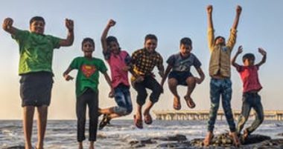
The Impact of DV Exposure Across the Lifespan
In Utero
School Age
Teen Years
Infant-Toddler
Preschool
Young Adulthood
Phonological awareness*
Reading difficulties
Reduced cognitive functioning, more academic difficulties
ADHD diagnosis
Higher negative affect & more negative cognitions
Lower social competence
Less positive and effective peer interactions*
Hypervigilant processing pattern
More likely to intervene with aggression in hypothetical interadult conflict
School absences and suspensions
Sleeping, eating, pain problem
Notes:
Particularly pronounced for children exposed to physical violence rooted in coercive control
Importance for emergent reading: is a broad skill that includes identifying and manipulating units of oral language – parts such as words, syllables, and onsets and rimes.
Phonological awareness* (cognitive ability to categorize similar sounds, rhyming, blending; predictors of reading ability)
More likely to meet the clinical criteria for Attention-deficit/hyperactive disorder
More conflict with friends, more peer problems,
Hypervigilant processing pattern: Among maltreated children, repeated victimization by parents may alter children’s representations of relationships in a way that makes them hypervigilant to signs of threat in other social contexts (Dodge et al., 1995).
This hypervigilant processing pattern, though adaptive in actual threat situations, might serve to fuel aggressive and hostile reactions in peer interactions, leading to negative feedback from peers that in turn serves to reinforce and nurture aggressive dispositions

Slide 23

The Impact of DV Exposure Across the Lifespan
In Utero
School Age
Teen Years
Infant-Toddler
Preschool
Young Adulthood
Internalizing symptoms
PTSD & major depressive disorder diagnosis
Lowered self-esteem
Anxiety & dissociation
Self-harm
Externalizing behaviors
Peer relationship difficulties (e.g., peer neglect, loneliness, conflict, bullying)
Dating violence
Antisocial/delinquent behaviors
Risk-tasking behaviors
Higher acceptance of VAW

Slide 24

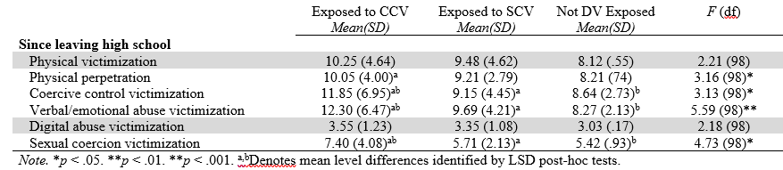
The Impact of DV Exposure Across the Lifespan
In Utero
School Age
Teen Years
Infant-Toddler
Preschool
Young Adulthood

Slide 25
The Impact of DV Exposure Across the Lifespan
In Utero
Adolescence
Childhood
Young Adulthood
Adulthood?
Notes:
Only carried into adulthood for those exposed to more severe and frequent violence
Cumulative impact or sleeper effect?
Association between IPV exposure and child adjustment problems grows overtime: increases by 40% EB and 117% internalizing; child may appear to be doing fine right at assessment, and exposure/trauma symptoms may be masked until later developmental stages (newly exposed)
Finding that the link between IPV exposure and child externalizing and internalizing problems strengthens over time is consistent with the idea of a sleeper effect.
Rather, their emergence is a process: They unfold and may crystallize over time in the context of events and experiences that often occur after the IPV.
This might include the development of harmful cognitions, such as insecurity or doubts about the stability of the family system or the safety of one or both parents (Bergman, Cummings, & Davies, 2014; Fosco, DeBoard, & Grych, 2007). It might also include the development of harmful reactions to IPV, such as attempts to intervene and stop their parents' violence (Jouriles, Rosenfield, McDonald, & Mueller, 2014).
Another hypothesis is that it is not a sleeper effect at all. Rather, the stronger associations are a result of cumulative effects of IPV over time. Specifically, children's exposure to IPV rarely happens as a single occurrence; it is often a repeated occurrence and in some families it is chronic (Margolin et al., 2009).
It is possible that the longer lag allows for the effects of greater cumulative exposure to IPV to be captured, and the stronger associations simply reflect
this.

Slide 26
Adverse Childhood Experiences (ACEs)

Slide 27
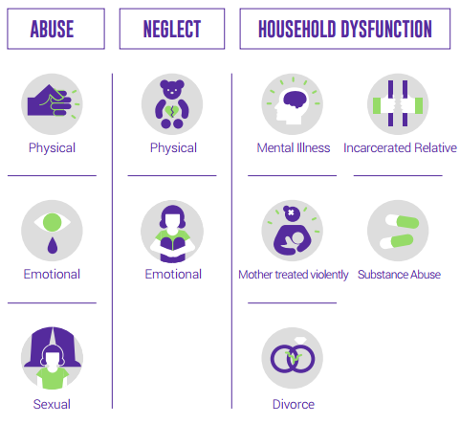
CDC-Kaiser Permanente Adverse Childhood Experiences (ACEs) Study
(Felitti et al., 1998)
1995-1997
17,000 HMO members from SoCal
Majority middle-class, well-educated
Notes:
ACE STUDY: one of the largest investigations of childhood abuse and neglect and later-life health and well-being.
Over 17,000 Health Maintenance Organization members from Southern California receiving physical exams completed confidential surveys regarding their childhood experiences and current health status and behaviors.
Adverse Childhood Experiences (ACEs) are common. Almost two-thirds of study participants reported at least one ACE, and more than one in five reported three or more ACEs.
The ACE score, a total sum of the different categories of ACEs reported by participants, is used to assess cumulative childhood stress.

Slide 28
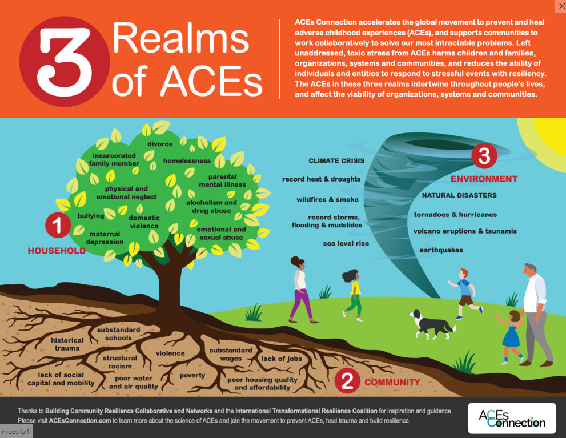

Slide 29
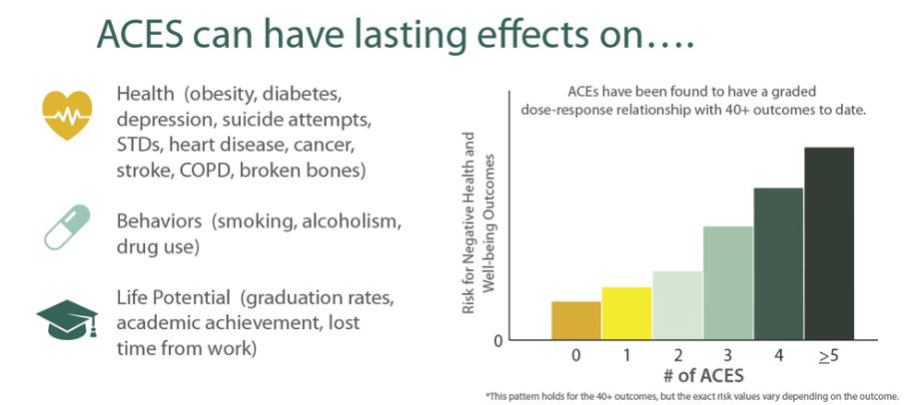
Dose-response relationship
Notes:
Study findings repeatedly reveal a graded dose-response relationship between ACEs and negative health and well-being outcomes across the life course.
Dose-response describes the change in an outcome (e.g., alcoholism) associated with differing levels of exposure (or doses) to a stressor (e.g. ACEs). A graded dose-response means that as the dose of the stressor increases the intensity of the outcome also increases.

Slide 30
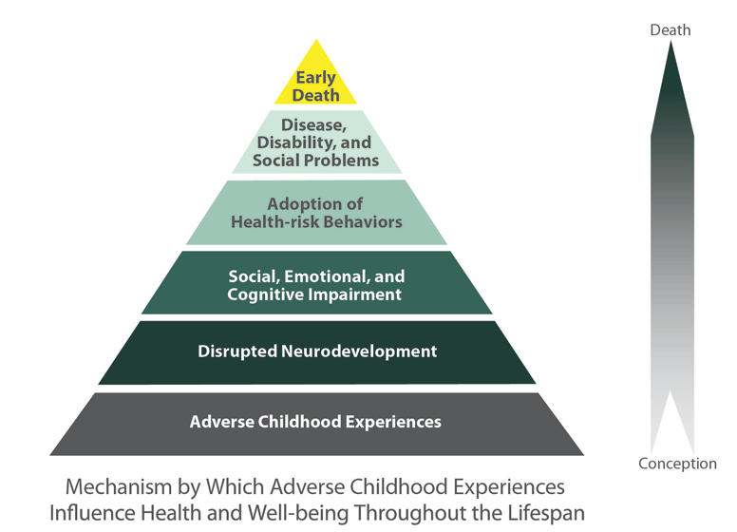
ACE
Pyramid
Notes:
R

Slide 31
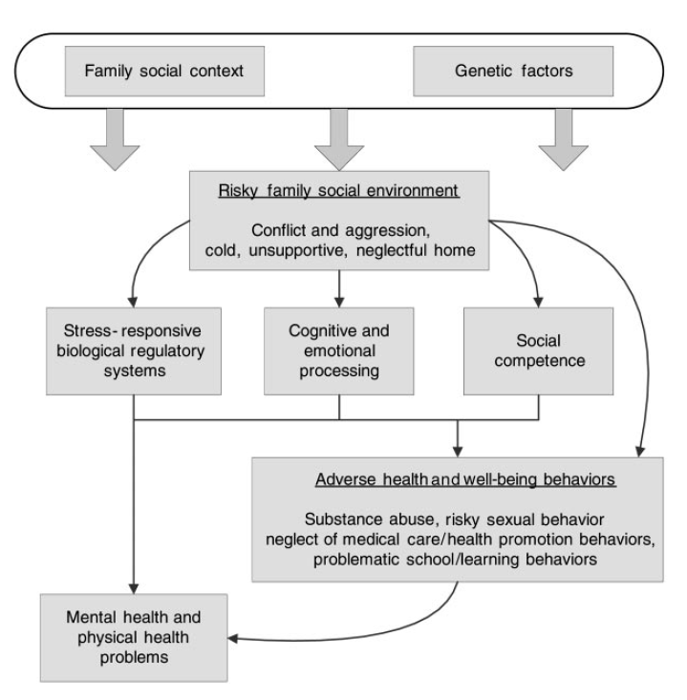
Developmental psychopathology (Cicchetti and colleagues)
Violence in the home interrupts or challenges child’s capacity of achieving developmental milestones
Notes:
Developmental psychopathology
(e.g., key regulatory competencies) like emotion regulation; theorizes that young children are more vulnerable because they have not had time to develop competencies that are promotive of resilience and wellbeing later in life
Lack of emotion regulation may make it difficult to establish positive peer groups – make them more likely to affiliate with deviant or aggressive peers

Slide 32
Moderating Factors
Vulnerability Factors
Child abuse & maltreatment
Prolonged DV exposure
Ongoing contact with maritally violent &/or abusive parent
Polyvictimization
Disadvantaged environments
Protective Factors
Ability to calm oneself
Secure maternal attachment (or other attachments)
Healthy maternal mental health
Mothers’ ability to shield child & discuss DV exposure
Disclosing & being believed
Positive & supportive peers and partners
Academic &/or extracurricular involvement
Social support & therapeutic interventions
Spirituality & transcendence
Notes:
****
Despite the host of risk factors associated with DV exposure, a sizable percentage of youth exposed to DV demonstrate resilience and healthy adaptation over time
Automatically defining witnessing as maltreatment is a mistake – Jeffrey Edleson
Ignore battered mothers’ efforts to develop safe environments for their children and themselves

Slide 33
Understanding Resilience & Posttraumatic Growth for Practical Implications
Resilience: “a dynamic process wherein individuals display positive adaptation despite experiences of significant adversity or trauma” (Luthar, Cicchetti & Becker, 2000, p. 543)
Pattern of positive adaptation (“doing okay,” “better-than-expected” outcomes) despite adversity
Can’t be captured at one time point
Struggling in one domain but still showing resilience
Posttraumatic growth: “positive psychological change experienced as a result of the struggle with highly challenging life circumstances” (Tedeshi & Calhoun, 2004, p. 1)
Growth and development that surpasses what was present before trauma occurred
Movement beyond pre-trauma levels of adaptation
Notes:
A child who shows resilience in some domains but difficulties in others does not indicate a lack of resilience, but rather illuminates the multidimensionality of the construct of resilience (Luthar et al).
Prevention & Intervention Efforts: helping DV-exposed youth use their experiences as tools for navigating future romantic relationships
Used their DV exposure experiences to help guide their partner selection, relationship maintenance and dissolution, and “red flag” detection skills

Slide 34
Practical Implications
One feeling I remember, and of course couldn't put the words to until much older, was that throughout my experience as a child witness to coercive controlling violence, I could almost sense the implicit bias of professionals that worked with me. I experienced some pretty awful stuff in my home growing up, absolutely, but the truth is I was a relatively resilient kid throughout. Being interviewed by different professionals, I often felt they were searching for particular answers, or for me to exhibit some expected behavior, rather than learning about what made me uniquely me.
Another thing that has always bothered me is the narrative that I (and people like me) am who I am "despite" my experiences. I firmly believe I am who I am as a direct result of my home growing up, violence and all. Growing up, I saw examples of extreme emotional dysregulation, manipulative communication, physical violence, parentification...in some ways my coping skills and personality grew in opposition to these behaviors. I also had the steadfast example of survivorship in my mother along the way. I also benefitted from a legal system that ultimately decided I should not be alone with my father because of how he treated my mother. At the same time, for all the ways in which he couldn't love my mother and me in healthy ways much of the time - there was still some good in him. Leaving space for that good and his complexity, has allowed me to thank him in some ways for some of the goodness in me. All of this lead me developing what I know is a healthy emotional intelligence which has helped me immensely in my relationships, profession, and in my own self-inquiry.
All of this to say that resilience and growth after trauma, at least from my own experience, is probably due to a complex a mix of heritage, time and place, DNA, and probably some magic. Also, dogs.
Notes:
I’M GOING TO CONCLUDE WITH A QUOTE FROM A YOUNG ADULT WHOSE MOTHER PARTICIPATED IN ONE OF MY STUDIES. SHE HAS REMAINED IN TOUCH WITH ME OVER THE YEARS, AS SHE IS VERY INTERESTED IN RESEARCH ON DV EXPOSURE AND RESILIENCE. I ASKED HER TO ANSWER THE QUESTION: what would you want professionals working with adolescents to know about you and other folks who have had similar backgrounds?
Here is her response

Slide 35
Children's Exposure to Domestic Violence:
A Risk & Resilience Perspective
Megan Haselschwerdt, Ph.D.
Associate Professor, Child & Family Studies
mhasel@utk.edu

